Slide 1

Sunday School
Matthew 7:13-14
Nathan Holmes
True Words Baptist Church – 1377 S. 20th St. Louisville, KY – TrueWordsBaptist.org

Slide 2
Matthew 7:13-14 Enter ye in at the strait gate: for wide is the gate, and broad is the way, that leadeth to destruction, and many there be which go in thereat: 14 Because strait is the gate, and narrow is the way, which leadeth unto life, and few there be that find it.

Slide 3
Title of the Lesson
Life or Destruction:
Choose Your Path
True Words Baptist Church – 1377 S. 20th St. Louisville, KY – TrueWordsBaptist.org

Slide 4
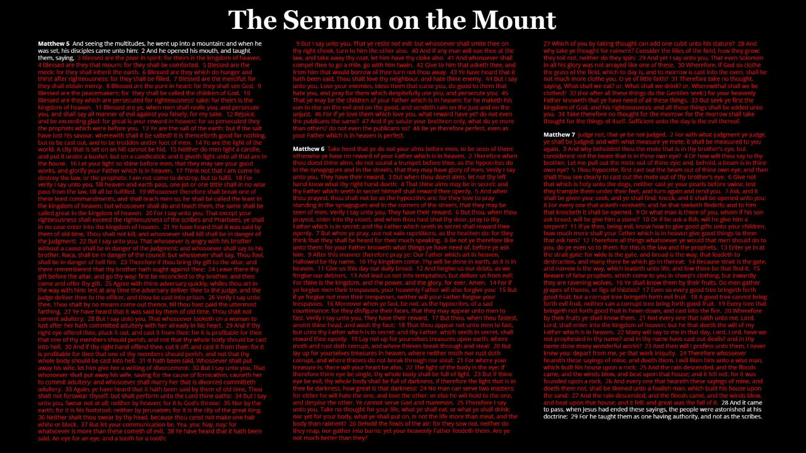

Slide 5
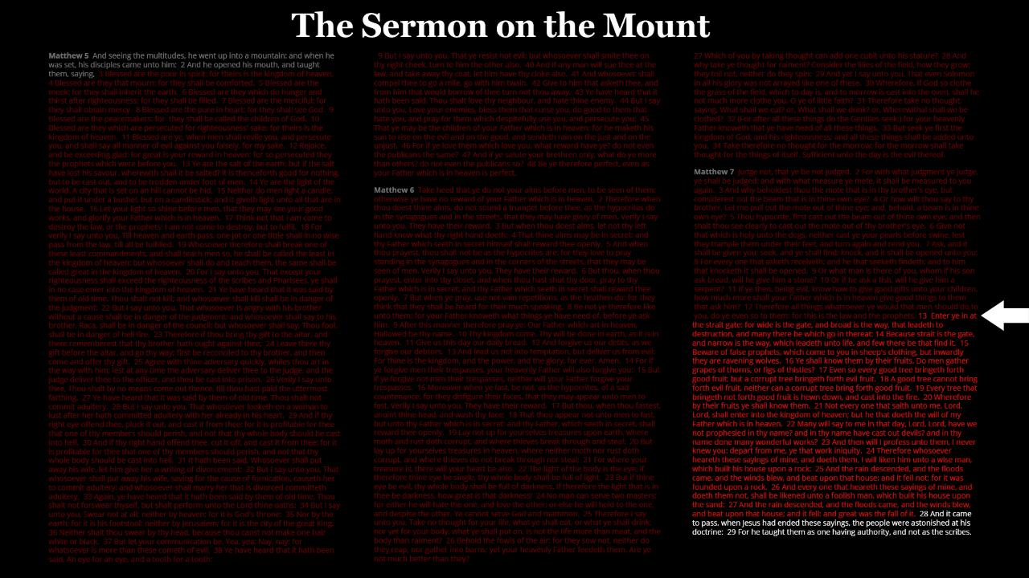

Slide 6
The Sermon On The Mount
Matthew 5
1-12 | The Blessed Life: Becoming Who Jesus Wants You To Be
13-16 | Salt and Light: Living an Impactful Christian Life
17-18 | The Law Fulfilled – Not Forgotten
19-20 | Zero Righteousness: Why the Pharisees are Burning
21-26 | Murder in the Heart – The Spirit of the Law
27-32 | Till Death Do Us Part: Lust, Divorce, and Eternal Consequences
33-37 | Let Your Word Be Enough
38-48 | The Mark of a True Son

Slide 7
The Sermon On The Mount
Matthew 6
1-8 | They Have Their Reward
9-13 | The Prayer That God Always Answers
14-18 | Forgiveness That Doesn’t Save
19-34 | Seek To Survive or Seek To Thrive

Slide 8
The Sermon On The Mount
Matthew 7
1-6 | Don’t Judge Me
7-12 | Asking For The Right Things
13-14 | Life or Destruction: Choose Your Path
15-23 | The Fruit of the Wicked
24-29 | In One Ear, Out the Other

Slide 9
Matthew 7:13-14 Enter ye in at the strait gate: for wide is the gate, and broad is the way, that leadeth to destruction, and many there be which go in thereat: 14 Because strait is the gate, and narrow is the way, which leadeth unto life, and few there be that find it.

Slide 10
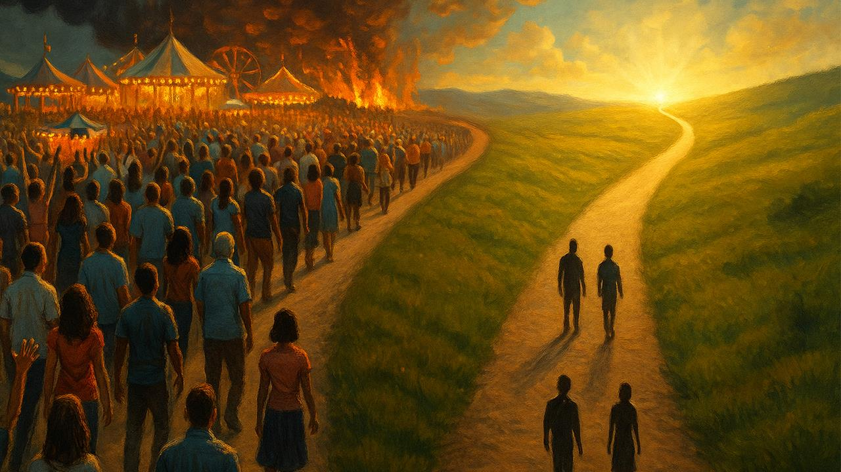

Slide 11
John 3:19-20 And this is the condemnation, that light is come into the world, and men loved darkness rather than light, because their deeds were evil. 20 For every one that doeth evil hateth the light, neither cometh to the light, lest his deeds should be reproved.

Slide 12
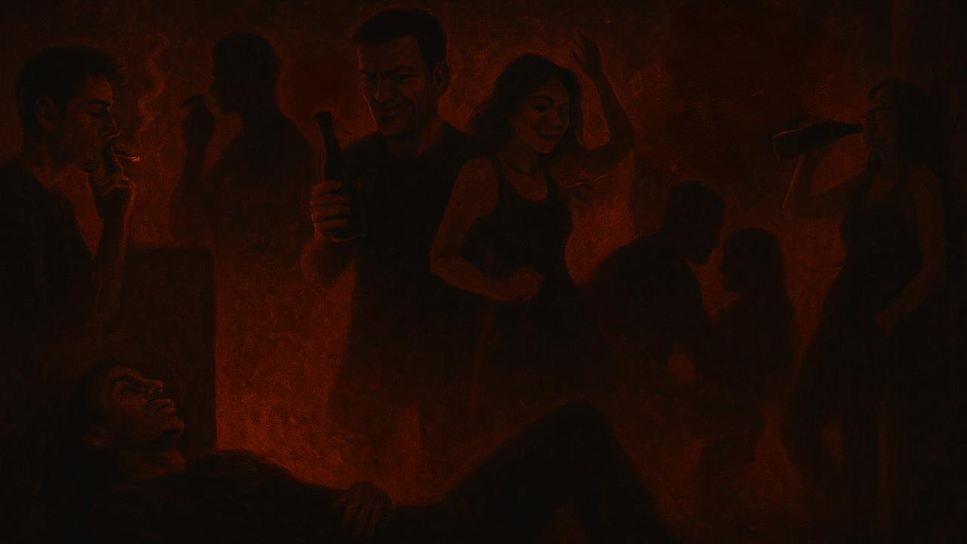

Slide 13
Hebrews 11:24-25 By faith Moses, when he was come to years, refused to be called the son of Pharaoh's daughter; 25 Choosing rather to suffer affliction with the people of God, than to enjoy the pleasures of sin for a season;

Slide 14
James 1:14-15 But every man is tempted, when he is drawn away of his own lust, and enticed. 15 Then when lust hath conceived, it bringeth forth sin: and sin, when it is finished, bringeth forth death.

Slide 15
Proverbs 14:12 There is a way which seemeth right unto a man, but the end thereof are the ways of death.

Slide 16
John 3:20-21 For every one that doeth evil hateth the light, neither cometh to the light, lest his deeds should be reproved. 21 But he that doeth truth cometh to the light, that his deeds may be made manifest, that they are wrought in God.

Slide 17
Ephesians 2:1-6 And you hath he quickened, who were dead in trespasses and sins; 2 Wherein in time past ye walked according to the course of this world, according to the prince of the power of the air, the spirit that now worketh in the children of disobedience: 3 Among whom also we all had our conversation in times past in the lusts of our flesh, fulfilling the desires of the flesh and of the mind; and were by nature the children of wrath, even as others.

Slide 18
4 But God, who is rich in mercy, for his great love wherewith he loved us, 5 Even when we were dead in sins, hath quickened us together with Christ, (by grace ye are saved;) 6 And hath raised us up together, and made us sit together in heavenly places in Christ Jesus:

Slide 19
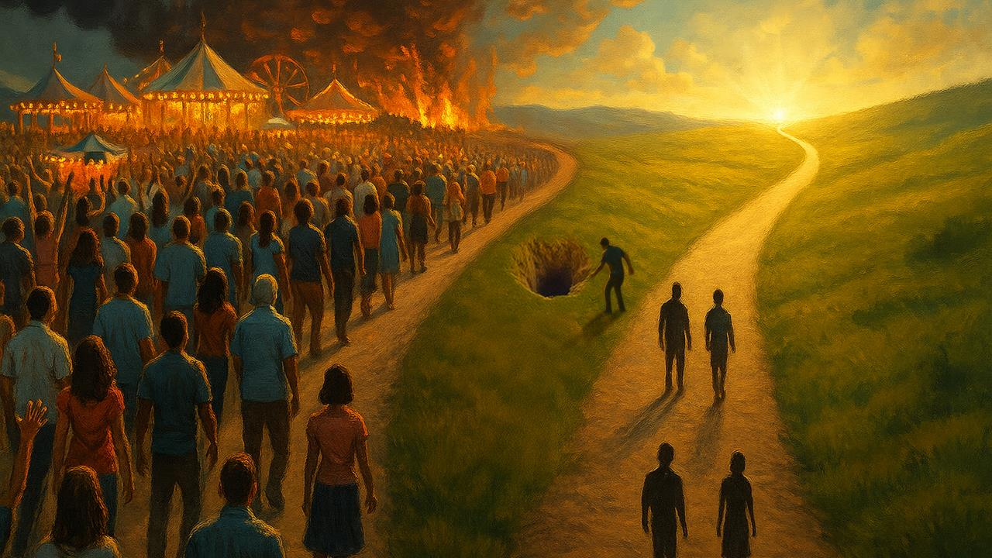

Slide 20
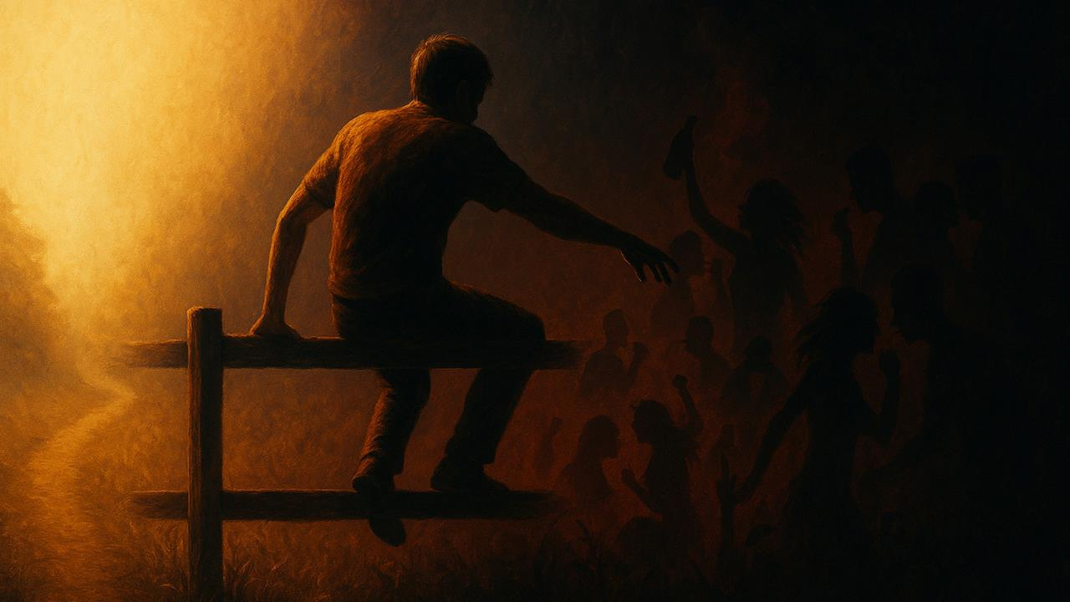

Slide 21
1 Corinthians 5:1 It is reported commonly that there is fornication among you, and such fornication as is not so much as named among the Gentiles, that one should have his father's wife.

Slide 22
1 Corinthians 5:2-5 And ye are puffed up, and have not rather mourned, that he that hath done this deed might be taken away from among you. 3 For I verily, as absent in body, but present in spirit, have judged already, as though I were present, concerning him that hath so done this deed, 4 In the name of our Lord Jesus Christ, when ye are gathered together, and my spirit, with the power of our Lord Jesus Christ,

Slide 23
5 To deliver such an one unto Satan for the destruction of the flesh, that the spirit may be saved in the day of the Lord Jesus.

Slide 24
1 Corinthians 3:15-17 If any man's work shall be burned, he shall suffer loss: but he himself shall be saved; yet so as by fire. 16 Know ye not that ye are the temple of God, and that the Spirit of God dwelleth in you? 17 If any man defile the temple of God, him shall God destroy; for the temple of God is holy, which temple ye are.

Slide 25
Colossians 3:5-6 Mortify therefore your members which are upon the earth; fornication, uncleanness, inordinate affection, evil concupiscence, and covetousness, which is idolatry: 6 For which things' sake the wrath of God cometh on the children of disobedience:

Slide 26
Galatians 2:20 I am crucified with Christ: nevertheless I live; yet not I, but Christ liveth in me: and the life which I now live in the flesh I live by the faith of the Son of God, who loved me, and gave himself for me.

Slide 27
Romans 6:6 Knowing this, that our old man is crucified with him, that the body of sin might be destroyed, that henceforth we should not serve sin.

Slide 28
Deuteronomy 30:19 I call heaven and earth to record this day against you, that I have set before you life and death, blessing and cursing: therefore choose life, that both thou and thy seed may live:

Slide 29
Proverbs 8:32 Now therefore hearken unto me, O ye children: for blessed are they that keep my ways.

Slide 30
Psalm 119:1-3. Blessed are the undefiled in the way, who walk in the law of the LORD. 2 Blessed are they that keep his testimonies, and that seek him with the whole heart. 3 They also do no iniquity: they walk in his ways.

Slide 31
Psalm 25:4-5 Shew me thy ways, O LORD; teach me thy paths. 5 Lead me in thy truth, and teach me: for thou art the God of my salvation; on thee do I wait all the day.

Slide 32
Psalm 16:11 Thou wilt shew me the path of life: in thy presence is fulness of joy; at thy right hand there are pleasures for evermore.

Slide 33
Visit Us:
TrueWordsBaptist.org
True Words Baptist Church – 1377 S. 20th St. Louisville, KY – TrueWordsBaptist.org

