Slide 1

Sunday Evening
Galatians 1:1-5
Joshua Tapp
True Words Baptist Church – 1377 S. 20th St. Louisville, KY – TrueWordsBaptist.org

Slide 2
Galatians 1:1-5 Paul, an apostle, (not of men, neither by man, but by Jesus Christ, and God the Father, who raised him from the dead;) 2 And all the brethren which are with me, unto the churches of Galatia: 3 Grace be to you and peace from God the Father, and from our Lord Jesus Christ, 4 Who gave himself for our sins, that he might deliver us from this present evil world, according to the will of God and our Father: 5 To whom be glory for ever and ever. Amen.

Slide 3
Title of the Sermon
Paul's Ordination: "Not of Men, But By Jesus Christ"
True Words Baptist Church – 1377 S. 20th St. Louisville, KY – TrueWordsBaptist.org

Slide 4
Galatians 1:1 Paul, an apostle, (not of men, neither by man, but by Jesus Christ, and God the Father, who raised him from the dead;)

Slide 5
Galatians 1:15–17 But when it pleased God, who separated me from my mother’s womb, and called me by his grace, 16 To reveal his Son in me, that I might preach him among the heathen; immediately I conferred not with flesh and blood: 17 Neither went I up to Jerusalem to them which were apostles before me; but I went into Arabia, and returned again unto Damascus.

Slide 6
1 Corinthians 15:7-10 After that, he was seen of James; then of all the apostles. 8 And last of all he was seen of me also, as of one born out of due time. 9 For I am the least of the apostles, that am not meet to be called an apostle, because I persecuted the church of God. 10 But by the grace of God I am what I am: and his grace which was bestowed upon me was not in vain; but I laboured more abundantly than they all: yet not I, but the grace of God which was with me.

Slide 7
Romans 1:1 Paul, a servant of Jesus Christ, called to be an apostle, separated unto the gospel of God,

Slide 8
1 Timothy 2:7 Whereunto I am ordained a preacher, and an apostle, (I speak the truth in Christ, and lie not;) a teacher of the Gentiles in faith and verity.

Slide 9
Ephesians 4:11 And he gave some, apostles; and some, prophets; and some, evangelists; and some, pastors and teachers;

Slide 10
Acts 13:2–3 As they ministered to the Lord, and fasted, the Holy Ghost said, Separate me Barnabas and Saul for the work whereunto I have called them. 3 And when they had fasted and prayed, and laid their hands on them, they sent them away.

Slide 11
Acts 9:15 But the Lord said unto him, Go thy way: for he is a chosen vessel unto me, to bear my name before the Gentiles, and kings, and the children of Israel:

Slide 12
Romans 1:1 Paul, a servant of Jesus Christ, called to be an apostle, separated unto the gospel of God,

Slide 13
Galatians 1:1 Paul, an apostle, (not of men, neither by man, but by Jesus Christ, and God the Father, who raised him from the dead;)

Slide 14
Acts 21:8 And the next day we that were of Paul’s company departed, and came unto Caesarea: and we entered into the house of Philip the evangelist, which was one of the seven; and abode with him.

Slide 15
1 Timothy 2:12 But I suffer not a woman to teach, nor to usurp authority over the man, but to be in silence.

Slide 16
2 Corinthians 12:12 Truly the signs of an apostle were wrought among you in all patience, in signs, and wonders, and mighty deeds.

Slide 17
2 Corinthians 10:8 For though I should boast somewhat more of our authority, which the Lord hath given us for edification, and not for your destruction, I should not be ashamed:

Slide 18
1 Corinthians 4:15–16 For though ye have ten thousand instructors in Christ, yet have ye not many fathers: for in Christ Jesus I have begotten you through the gospel. 16 Wherefore I beseech you, be ye followers of me.

Slide 19
Titus 1:5 For this cause left I thee in Crete, that thou shouldest set in order the things that are wanting, and ordain elders in every city, as I had appointed thee:

Slide 20
Romans 11:13 For I speak to you Gentiles, inasmuch as I am the apostle of the Gentiles, I magnify mine office:

Slide 21
1 Corinthians 15:8 And last of all he was seen of me also, as of one born out of due time.

Slide 22
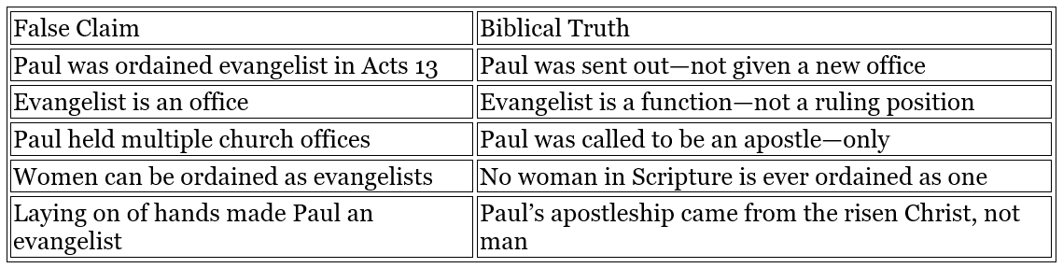

Slide 23
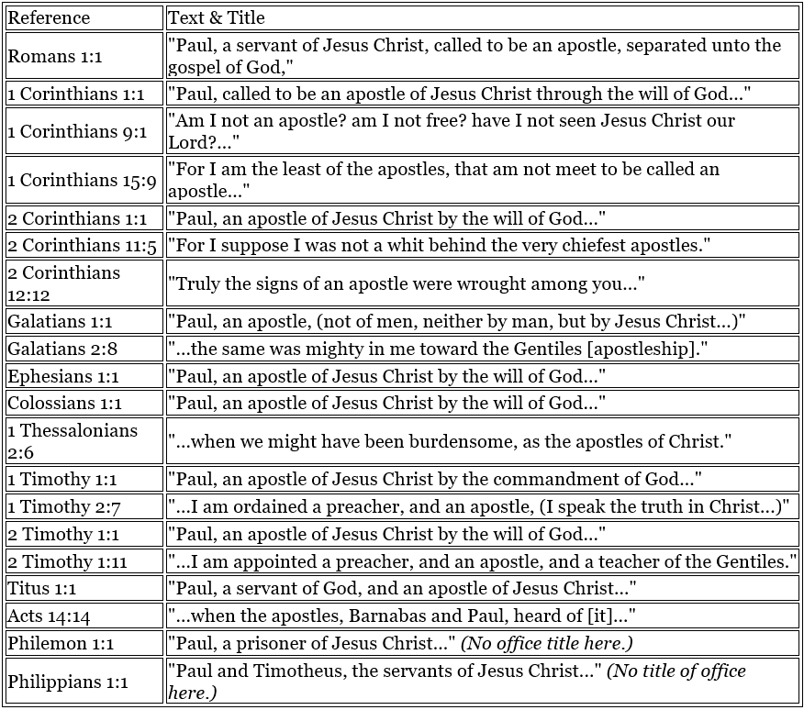

Slide 24
Visit Us:
TrueWordsBaptist.org
True Words Baptist Church – 1377 S. 20th St. Louisville, KY – TrueWordsBaptist.org

