Slide 1

Thursday Bible Study
Numbers 29:1-6
Joshua Tapp
True Words Baptist Church – 1377 S. 20th St. Louisville, KY – TrueWordsBaptist.org

Slide 2
Numbers 29:1-3 And in the seventh month, on the first day of the month, ye shall have an holy convocation; ye shall do no servile work: it is a day of blowing the trumpets unto you. 2 And ye shall offer a burnt offering for a sweet savour unto the LORD; one young bullock, one ram, and seven lambs of the first year without blemish: 3 And their meat offering shall be of flour mingled with oil, three tenth deals for a bullock, and two tenth deals for a ram,

Slide 3
Numbers 29:4-6 And one tenth deal for one lamb, throughout the seven lambs: 5 And one kid of the goats for a sin offering, to make an atonement for you: 6 Beside the burnt offering of the month, and his meat offering, and the daily burnt offering, and his meat offering, and their drink offerings, according unto their manner, for a sweet savour, a sacrifice made by fire unto the LORD.

Slide 4
Title of the Bible Study
Sound the Alarm: The Feast That Warns
True Words Baptist Church – 1377 S. 20th St. Louisville, KY – TrueWordsBaptist.org

Slide 5
Leviticus 23:2 Speak unto the children of Israel, and say unto them, Concerning the feasts of the LORD, which ye shall proclaim to be holy convocations, even these are my feasts.

Slide 6
Leviticus 23:24-25 Speak unto the children of Israel, saying, In the seventh month, in the first day of the month, shall ye have a sabbath, a memorial of blowing of trumpets, an holy convocation. 25 Ye shall do no servile work therein: but ye shall offer an offering made by fire unto the LORD.

Slide 7
Leviticus 23:24 Speak unto the children of Israel, saying, In the seventh month, in the first day of the month, shall ye have a sabbath, a memorial of blowing of trumpets, an holy convocation.

Slide 8
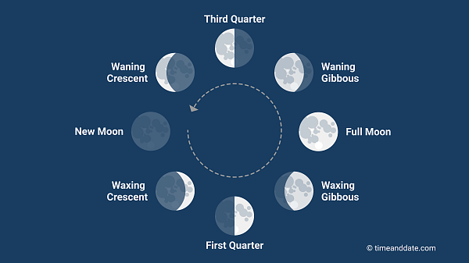

Slide 9
Leviticus 23:24-25 Speak unto the children of Israel, saying, In the seventh month, in the first day of the month, shall ye have a sabbath, a memorial of blowing of trumpets, an holy convocation. 25 Ye shall do no servile work therein: but ye shall offer an offering made by fire unto the LORD.

Slide 10
Numbers 29:1-3 And in the seventh month, on the first day of the month, ye shall have an holy convocation; ye shall do no servile work: it is a day of blowing the trumpets unto you. 2 And ye shall offer a burnt offering for a sweet savour unto the LORD; one young bullock, one ram, and seven lambs of the first year without blemish: 3 And their meat offering shall be of flour mingled with oil, three tenth deals for a bullock, and two tenth deals for a ram,

Slide 11
Numbers 29:4-6 And one tenth deal for one lamb, throughout the seven lambs: 5 And one kid of the goats for a sin offering, to make an atonement for you: 6 Beside the burnt offering of the month, and his meat offering, and the daily burnt offering, and his meat offering, and their drink offerings, according unto their manner, for a sweet savour, a sacrifice made by fire unto the LORD.

Slide 12
Numbers 10:1-3 And the LORD spake unto Moses, saying, 2 Make thee two trumpets of silver; of a whole piece shalt thou make them: that thou mayest use them for the calling of the assembly, and for the journeying of the camps. 3 And when they shall blow with them, all the assembly shall assemble themselves to thee at the door of the tabernacle of the congregation.

Slide 13
Numbers 10:4 And if they blow but with one trumpet, then the princes, which are heads of the thousands of Israel, shall gather themselves unto thee.

Slide 14
Numbers 10:5-6 When ye blow an alarm, then the camps that lie on the east parts shall go forward. 6 When ye blow an alarm the second time, then the camps that lie on the south side shall take their journey: they shall blow an alarm for their journeys.

Slide 15
Numbers 10:7-9 But when the congregation is to be gathered together, ye shall blow, but ye shall not sound an alarm. 8 And the sons of Aaron, the priests, shall blow with the trumpets; and they shall be to you for an ordinance for ever throughout your generations. 9 And if ye go to war in your land against the enemy that oppresseth you, then ye shall blow an alarm with the trumpets; and ye shall be remembered before the LORD your God, and ye shall be saved from your enemies.

Slide 16
Numbers 10:10 Also in the day of your gladness, and in your solemn days, and in the beginnings of your months, ye shall blow with the trumpets over your burnt offerings, and over the sacrifices of your peace offerings; that they may be to you for a memorial before your God: I am the LORD your God.

Slide 17
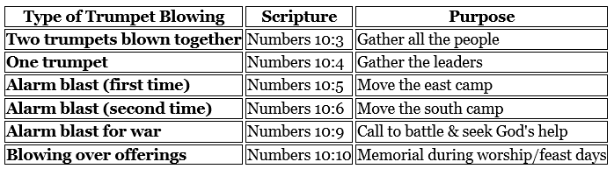

Slide 18
Leviticus 23:24 Speak unto the children of Israel, saying, In the seventh month, in the first day of the month, shall ye have a sabbath, a memorial of blowing of trumpets, an holy convocation.

Slide 19
Numbers 10:10 Also in the day of your gladness, and in your solemn days, and in the beginnings of your months, ye shall blow with the trumpets over your burnt offerings, and over the sacrifices of your peace offerings; that they may be to you for a memorial before your God: I am the LORD your God.

Slide 20
Matthew 24:15-17 When ye therefore shall see the abomination of desolation, spoken of by Daniel the prophet, stand in the holy place, (whoso readeth, let him understand:) 16 Then let them which be in Judaea flee into the mountains: 17 Let him which is on the housetop not come down to take any thing out of his house:

Slide 21
Matthew 24:18-21 Neither let him which is in the field return back to take his clothes. 19 And woe unto them that are with child, and to them that give suck in those days! 20 But pray ye that your flight be not in the winter, neither on the sabbath day: 21 For then shall be great tribulation, such as was not since the beginning of the world to this time, no, nor ever shall be.

Slide 22
Matthew 24:22 And except those days should be shortened, there should no flesh be saved: but for the elect's sake those days shall be shortened.

Slide 23
Revelation 13:7 And it was given unto him to make war with the saints, and to overcome them: and power was given him over all kindreds, and tongues, and nations.

Slide 24
Visit Us:
TrueWordsBaptist.org
True Words Baptist Church – 1377 S. 20th St. Louisville, KY – TrueWordsBaptist.org

