Slide 1

Sunday School
Matthew 4:12-17
Joshua Tapp
True Words Baptist Church – 1377 S. 20th St. Louisville, KY – TrueWordsBaptist.org

Slide 2
Matthew 4:12-14 Now when Jesus had heard that John was cast into prison, he departed into Galilee; 13 And leaving Nazareth, he came and dwelt in Capernaum, which is upon the sea coast, in the borders of Zabulon and Nephthalim: 14 That it might be fulfilled which was spoken by Esaias the prophet, saying,

Slide 3
Matthew 4:15-17 The land of Zabulon, and the land of Nephthalim, by the way of the sea, beyond Jordan, Galilee of the Gentiles; 16 The people which sat in darkness saw great light; and to them which sat in the region and shadow of death light is sprung up. 17 From that time Jesus began to preach, and to say, Repent: for the kingdom of heaven is at hand.

Slide 4
Title of the Lesson:
People in Darkness
Saw Great Light
True Words Baptist Church – 1377 S. 20th St. Louisville, KY – TrueWordsBaptist.org

Slide 5
Matthew 4:12 Now when Jesus had heard that John was cast into prison, he departed into Galilee;

Slide 6
Matthew 4:13 And leaving Nazareth, he came and dwelt in Capernaum, which is upon the sea coast, in the borders of Zabulon and Nephthalim:

Slide 7
Matthew 11:1-3 And it came to pass, when Jesus had made an end of commanding his twelve disciples, he departed thence to teach and to preach in their cities. 2 Now when John had heard in the prison the works of Christ, he sent two of his disciples, 3 And said unto him, Art thou he that should come, or do we look for another?

Slide 8
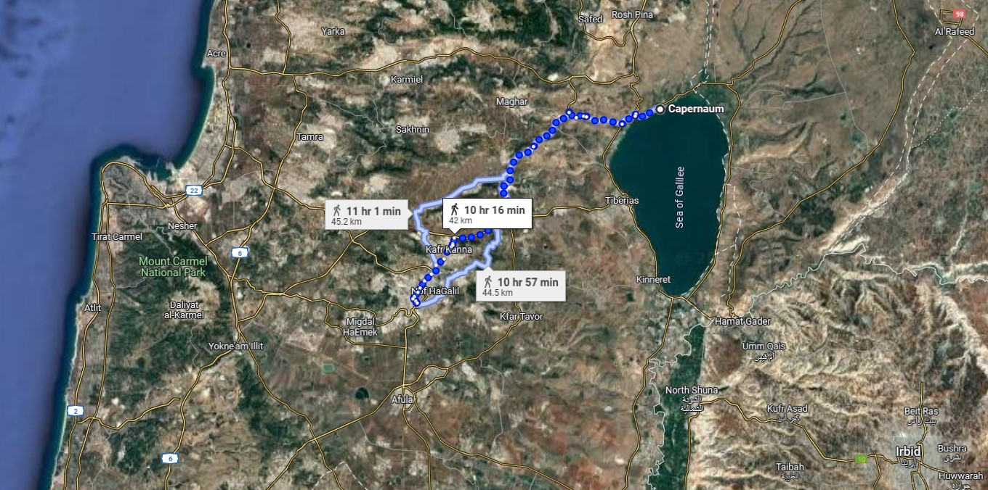

Slide 9
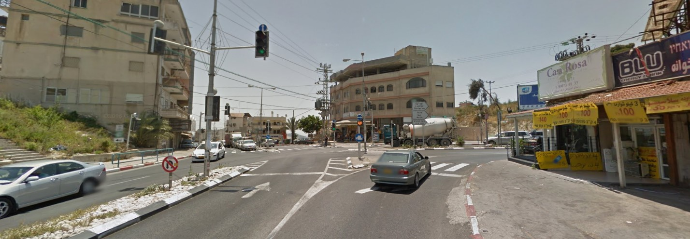

Slide 10
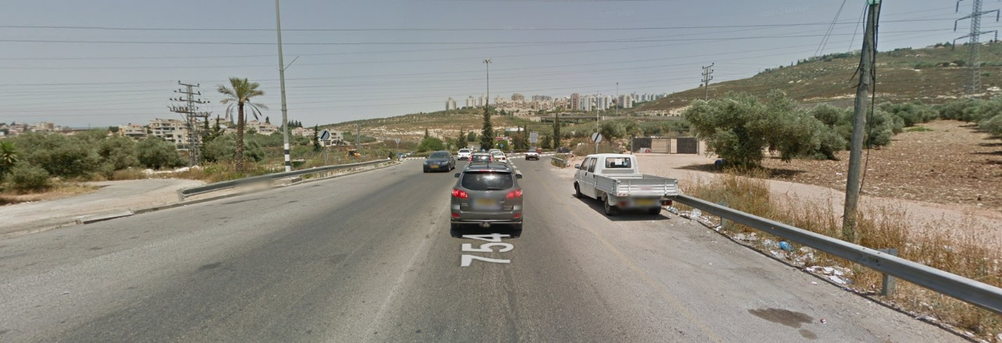

Slide 11
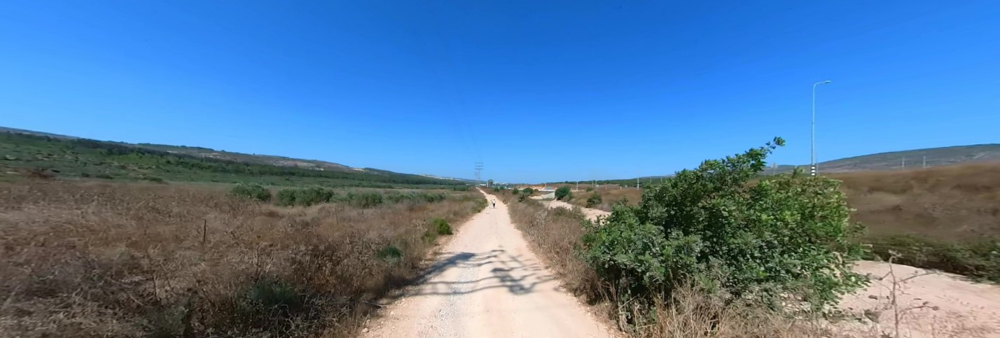

Slide 12
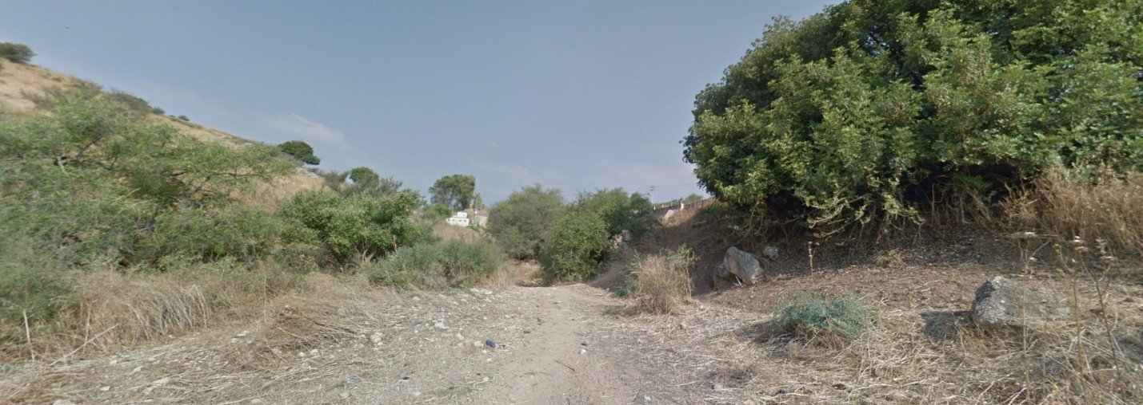

Slide 13
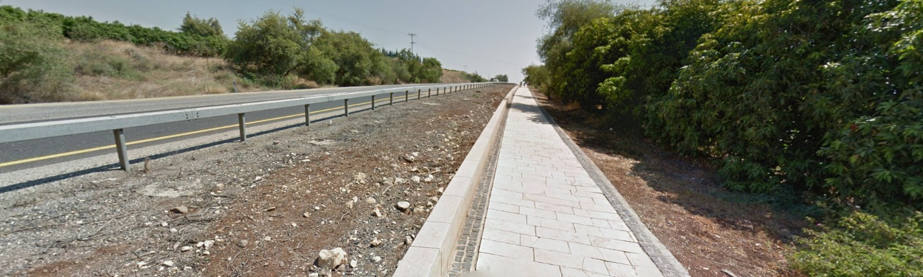

Slide 14
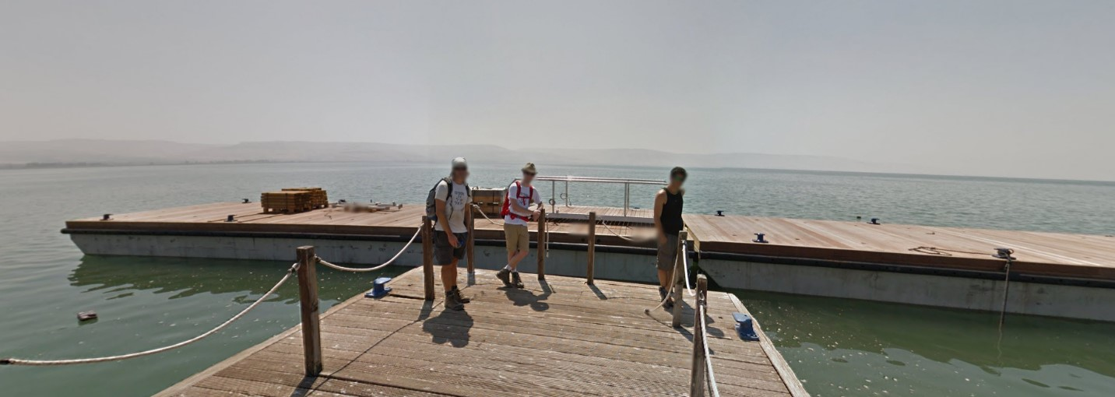

Slide 15
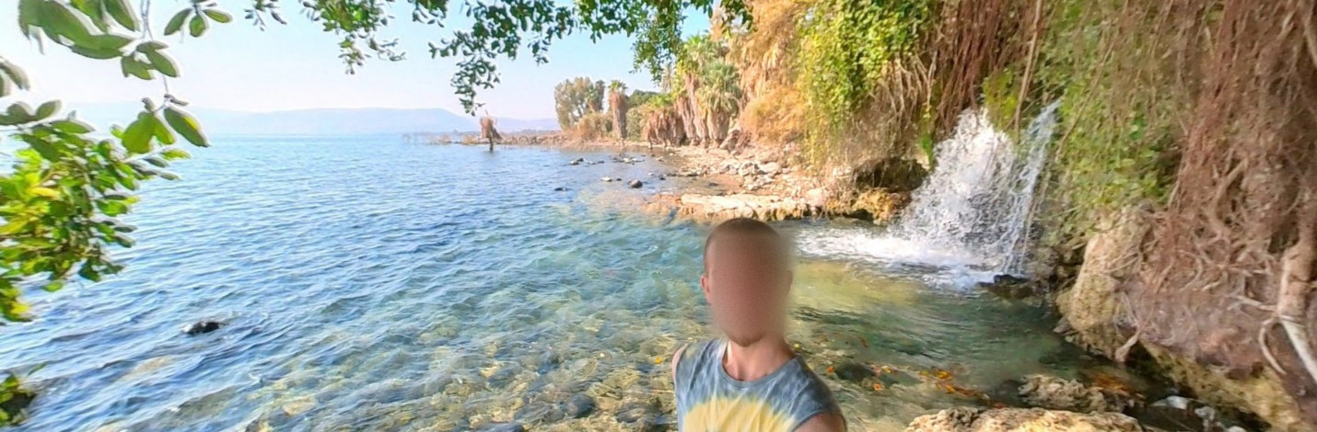

Slide 16
Matthew 4:13-16 And leaving Nazareth, he came and dwelt in Capernaum, which is upon the sea coast, in the borders of Zabulon and Nephthalim: 14 That it might be fulfilled which was spoken by Esaias the prophet, saying, 15 The land of Zabulon, and the land of Nephthalim, by the way of the sea, beyond Jordan, Galilee of the Gentiles; 16 The people which sat in darkness saw great light; and to them which sat in the region and shadow of death light is sprung up.

Slide 17
Matthew 4:14-16 That it might be fulfilled which was spoken by Esaias the prophet, saying, 15 The land of Zabulon, and the land of Nephthalim, by the way of the sea, beyond Jordan, Galilee of the Gentiles; 16 The people which sat in darkness saw great light; and to them which sat in the region and shadow of death light is sprung up.

Slide 18
Isaiah 9:1-2 Nevertheless the dimness shall not be such as was in her vexation, when at the first he lightly afflicted the land of Zebulun and the land of Naphtali, and afterward did more grievously afflict her by the way of the sea, beyond Jordan, in Galilee of the nations. 2 The people that walked in darkness have seen a great light: they that dwell in the land of the shadow of death, upon them hath the light shined.

Slide 19
John 1:5 And the light shineth in darkness; and the darkness comprehended it not.

Slide 20
John 8:12 Then spake Jesus again unto them, saying, I am the light of the world: he that followeth me shall not walk in darkness, but shall have the light of life.

Slide 21
John 9:5 As long as I am in the world, I am the light of the world.

Slide 22
Matthew 5:14-16 Ye are the light of the world. A city that is set on an hill cannot be hid. 15 Neither do men light a candle, and put it under a bushel, but on a candlestick; and it giveth light unto all that are in the house. 16 Let your light so shine before men, that they may see your good works, and glorify your Father which is in heaven.

Slide 23
Ephesians 5:8-11 For ye were sometimes darkness, but now are ye light in the Lord: walk as children of light: 9 (For the fruit of the Spirit is in all goodness and righteousness and truth;) 10 Proving what is acceptable unto the Lord. 11 And have no fellowship with the unfruitful works of darkness, but rather reprove them.

Slide 24
Matthew 4:18-22 And Jesus, walking by the sea of Galilee, saw two brethren, Simon called Peter, and Andrew his brother, casting a net into the sea: for they were fishers. 19 And he saith unto them, Follow me, and I will make you fishers of men. 20 And they straightway left their nets, and followed him. 21 And going on from thence, he saw other two brethren, James the son of Zebedee, and John his brother, in a ship with Zebedee their father, mending their nets; and he called them. 22 And they immediately left the ship and their father, and followed him.

Slide 25
1 Corinthians 11:1 Be ye followers of me, even as I also am of Christ.

Slide 26
Visit Us:
TrueWordsBaptist.org
True Words Baptist Church – 1377 S. 20th St. Louisville, KY – TrueWordsBaptist.org

