Slide 1

Thursday Bible Study
Leviticus 23:4-44
Joshua Tapp
True Words Baptist Church – 1377 S. 20th St. Louisville, KY – TrueWordsBaptist.org

Slide 2
Title of the Bible Study
The Seven Feasts of the Lord: God's Plan Revealed
True Words Baptist Church – 1377 S. 20th St. Louisville, KY – TrueWordsBaptist.org

Slide 3
1. Passover
2. Feast of Unleavened Bread
3. Firstfruits
4. Feast of Weeks
5. Blowing of the Trumpets
6. Day of Atonement
7. Feast of Tabernacles

Slide 4
1. Passover, Feast of Unleavened Bread, Firstfruits
2. Feast of Weeks
3. Blowing of the Trumpets, Day of Atonement, Feast of Tabernacles

Slide 5
Leviticus 23:5 In the fourteenth day of the first month at even is the LORD'S passover.

Slide 6
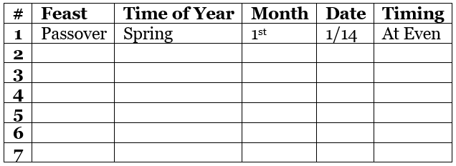

Slide 7
Leviticus 23:5-7 In the fourteenth day of the first month at even is the LORD'S passover. 6 And on the fifteenth day of the same month is the feast of unleavened bread unto the LORD: seven days ye must eat unleavened bread. 7 In the first day ye shall have an holy convocation: ye shall do no servile work therein.

Slide 8
Exodus 12:18 In the first month, on the fourteenth day of the month at even, ye shall eat unleavened bread, until the one and twentieth day of the month at even.

Slide 9
Ezekiel 45:21 In the first month, in the fourteenth day of the month, ye shall have the passover, a feast of seven days; unleavened bread shall be eaten.

Slide 10
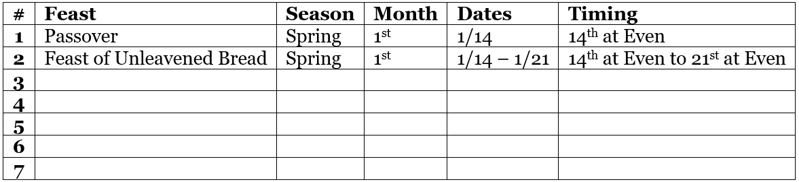

Slide 11
Leviticus 23:10-11 Speak unto the children of Israel, and say unto them, When ye be come into the land which I give unto you, and shall reap the harvest thereof, then ye shall bring a sheaf of the firstfruits of your harvest unto the priest: 11 And he shall wave the sheaf before the LORD, to be accepted for you: on the morrow after the sabbath the priest shall wave it.

Slide 12
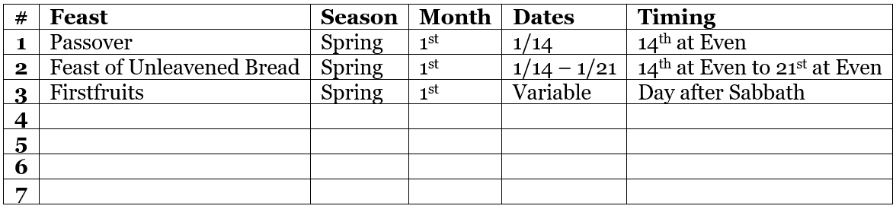

Slide 13
Leviticus 23:15-16 And ye shall count unto you from the morrow after the sabbath, from the day that ye brought the sheaf of the wave offering; seven sabbaths shall be complete: 16 Even unto the morrow after the seventh sabbath shall ye number fifty days; and ye shall offer a new meat offering unto the LORD.

Slide 14
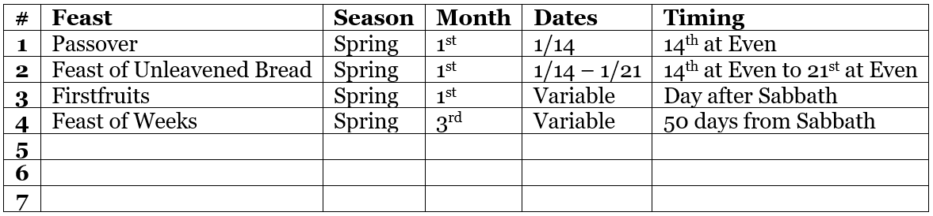

Slide 15
Matthew 13:24-27 Another parable put he forth unto them, saying, The kingdom of heaven is likened unto a man which sowed good seed in his field: 25 But while men slept, his enemy came and sowed tares among the wheat, and went his way. 26 But when the blade was sprung up, and brought forth fruit, then appeared the tares also. 27 So the servants of the householder came and said unto him, Sir, didst not thou sow good seed in thy field? from whence then hath it tares?

Slide 16
Matthew 13:28-30 He said unto them, An enemy hath done this. The servants said unto him, Wilt thou then that we go and gather them up? 29 But he said, Nay; lest while ye gather up the tares, ye root up also the wheat with them. 30 Let both grow together until the harvest: and in the time of harvest I will say to the reapers, Gather ye together first the tares, and bind them in bundles to burn them: but gather the wheat into my barn.

Slide 17
Leviticus 23:23-25 And the LORD spake unto Moses, saying, 24 Speak unto the children of Israel, saying, In the seventh month, in the first day of the month, shall ye have a sabbath, a memorial of blowing of trumpets, an holy convocation. 25 Ye shall do no servile work therein: but ye shall offer an offering made by fire unto the LORD.

Slide 18
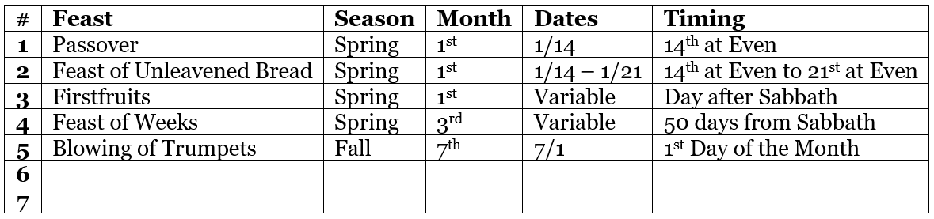

Slide 19
Numbers 10:9 And if ye go to war in your land against the enemy that oppresseth you, then ye shall blow an alarm with the trumpets; and ye shall be remembered before the LORD your God, and ye shall be saved from your enemies.

Slide 20
Leviticus 23:27-28 Also on the tenth day of this seventh month there shall be a day of atonement: it shall be an holy convocation unto you; and ye shall afflict your souls, and offer an offering made by fire unto the LORD. 28 And ye shall do no work in that same day: for it is a day of atonement, to make an atonement for you before the LORD your God.

Slide 21
Leviticus 23:32 It shall be unto you a sabbath of rest, and ye shall afflict your souls: in the ninth day of the month at even, from even unto even, shall ye celebrate your sabbath.

Slide 22
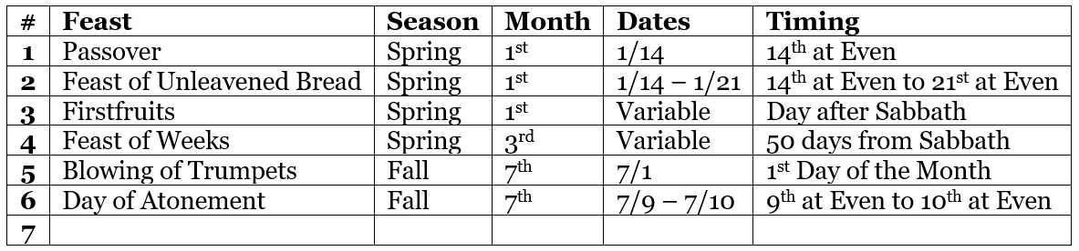

Slide 23
Leviticus 23:34 Speak unto the children of Israel, saying, The fifteenth day of this seventh month shall be the feast of tabernacles for seven days unto the LORD.

Slide 24
Leviticus 23:39 Also in the fifteenth day of the seventh month, when ye have gathered in the fruit of the land, ye shall keep a feast unto the LORD seven days: on the first day shall be a sabbath, and on the eighth day shall be a sabbath.

Slide 25
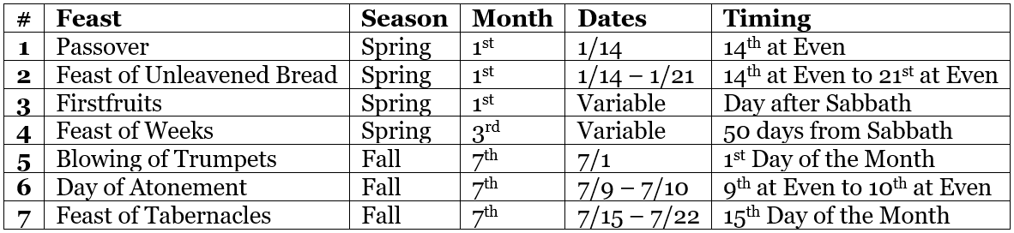

Slide 26
Visit Us:
TrueWordsBaptist.org
True Words Baptist Church – 1377 S. 20th St. Louisville, KY – TrueWordsBaptist.org

