Slide 1

Thursday Bible Study
1 Corinthians 15:12-24
Joshua Tapp
True Words Baptist Church – 1377 S. 20th St. Louisville, KY – TrueWordsBaptist.org

Slide 2
Title of the Bible Study
The Resurrection From the Dead
True Words Baptist Church – 1377 S. 20th St. Louisville, KY – TrueWordsBaptist.org

Slide 3
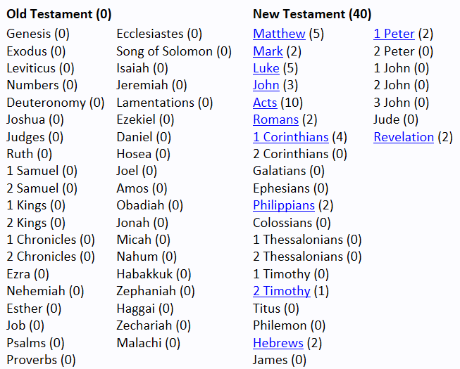

Slide 4
Job 19:25-27 For I know that my redeemer liveth, and that he shall stand at the latter day upon the earth: 26 And though after my skin worms destroy this body, yet in my flesh shall I see God: 27 Whom I shall see for myself, and mine eyes shall behold, and not another; though my reins be consumed within me.

Slide 5
Psalm 16:10 For thou wilt not leave my soul in hell; neither wilt thou suffer thine Holy One to see corruption.

Slide 6
Acts 2:24 Whom God hath raised up, having loosed the pains of death: because it was not possible that he should be holden of it.

Slide 7
Acts 2:27 Because thou wilt not leave my soul in hell, neither wilt thou suffer thine Holy One to see corruption.

Slide 8
Acts 2:31-32 He seeing this before spake of the resurrection of Christ, that his soul was not left in hell, neither his flesh did see corruption. 32 This Jesus hath God raised up, whereof we all are witnesses.

Slide 9
Isaiah 26:19 Thy dead men shall live, together with my dead body shall they arise. Awake and sing, ye that dwell in dust: for thy dew is as the dew of herbs, and the earth shall cast out the dead.

Slide 10
Daniel 12:2 And many of them that sleep in the dust of the earth shall awake, some to everlasting life, and some to shame and everlasting contempt.

Slide 11
Ezekiel 37:12-14 Therefore prophesy and say unto them, Thus saith the Lord GOD; Behold, O my people, I will open your graves, and cause you to come up out of your graves, and bring you into the land of Israel. 13 And ye shall know that I am the LORD, when I have opened your graves, O my people, and brought you up out of your graves, 14 And shall put my spirit in you, and ye shall live, and I shall place you in your own land: then shall ye know that I the LORD have spoken it, and performed it, saith the LORD.

Slide 12
Hosea 13:14 I will ransom them from the power of the grave; I will redeem them from death: O death, I will be thy plagues; O grave, I will be thy destruction: repentance shall be hid from mine eyes.

Slide 13
Matthew 22:23-24 The same day came to him the Sadducees, which say that there is no resurrection, and asked him, 24 Saying, Master, Moses said, If a man die, having no children, his brother shall marry his wife, and raise up seed unto his brother.

Slide 14
Matthew 22:29-32 Jesus answered and said unto them, Ye do err, not knowing the scriptures, nor the power of God. 30 For in the resurrection they neither marry, nor are given in marriage, but are as the angels of God in heaven. 31 But as touching the resurrection of the dead, have ye not read that which was spoken unto you by God, saying, 32 I am the God of Abraham, and the God of Isaac, and the God of Jacob? God is not the God of the dead, but of the living.

Slide 15
John 5:28-29 Marvel not at this: for the hour is coming, in the which all that are in the graves shall hear his voice, 29 And shall come forth; they that have done good, unto the resurrection of life; and they that have done evil, unto the resurrection of damnation.

Slide 16
John 11:23-24 Jesus saith unto her, Thy brother shall rise again. 24 Martha saith unto him, I know that he shall rise again in the resurrection at the last day.

Slide 17
Acts 24:15 And have hope toward God, which they themselves also allow, that there shall be a resurrection of the dead, both of the just and unjust.

Slide 18
2 Timothy 2:17-18 And their word will eat as doth a canker: of whom is Hymenaeus and Philetus; 18 Who concerning the truth have erred, saying that the resurrection is past already; and overthrow the faith of some.

Slide 19
Revelation 20:5-6 But the rest of the dead lived not again until the thousand years were finished. This is the first resurrection. 6 Blessed and holy is he that hath part in the first resurrection: on such the second death hath no power, but they shall be priests of God and of Christ, and shall reign with him a thousand years.

Slide 20
1 Corinthians 15:12-14 Now if Christ be preached that he rose from the dead, how say some among you that there is no resurrection of the dead? 13 But if there be no resurrection of the dead, then is Christ not risen: 14 And if Christ be not risen, then is our preaching vain, and your faith is also vain.

Slide 21
1 Corinthians 15:15-17 Yea, and we are found false witnesses of God; because we have testified of God that he raised up Christ: whom he raised not up, if so be that the dead rise not. 16 For if the dead rise not, then is not Christ raised: 17 And if Christ be not raised, your faith is vain; ye are yet in your sins.

Slide 22
1 Corinthians 15:20 But now is Christ risen from the dead, and become the firstfruits of them that slept.

Slide 23
1 Kings 17:20-22 And he cried unto the LORD, and said, O LORD my God, hast thou also brought evil upon the widow with whom I sojourn, by slaying her son? 21 And he stretched himself upon the child three times, and cried unto the LORD, and said, O LORD my God, I pray thee, let this child's soul come into him again. 22 And the LORD heard the voice of Elijah; and the soul of the child came into him again, and he revived.

Slide 24
1 Corinthians 15:23-26 But every man in his own order: Christ the firstfruits; afterward they that are Christ's at his coming. 24 Then cometh the end, when he shall have delivered up the kingdom to God, even the Father; when he shall have put down all rule and all authority and power. 25 For he must reign, till he hath put all enemies under his feet. 26 The last enemy that shall be destroyed is death.

Slide 25
Revelation 20:11-12 And I saw a great white throne, and him that sat on it, from whose face the earth and the heaven fled away; and there was found no place for them. 12 And I saw the dead, small and great, stand before God; and the books were opened: and another book was opened, which is the book of life: and the dead were judged out of those things which were written in the books, according to their works.

Slide 26
Revelation 20:13-15 And the sea gave up the dead which were in it; and death and hell delivered up the dead which were in them: and they were judged every man according to their works. 14 And death and hell were cast into the lake of fire. This is the second death. 15 And whosoever was not found written in the book of life was cast into the lake of fire.

Slide 27
Visit Us:
TrueWordsBaptist.org
True Words Baptist Church – 1377 S. 20th St. Louisville, KY – TrueWordsBaptist.org

