Slide 1

Thursday Bible Study
Exodus 25:17-22
Joshua Tapp
True Words Baptist Church – 1377 S. 20th St. Louisville, KY – TrueWordsBaptist.org

Slide 2
Title of the Bible Study
The Mercy Seat
True Words Baptist Church – 1377 S. 20th St. Louisville, KY – TrueWordsBaptist.org

Slide 3
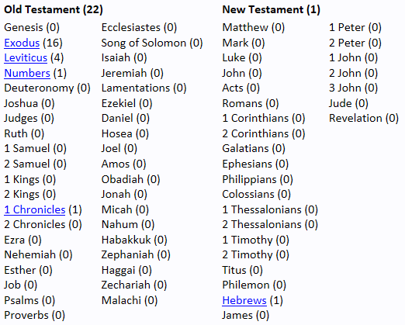


Slide 4
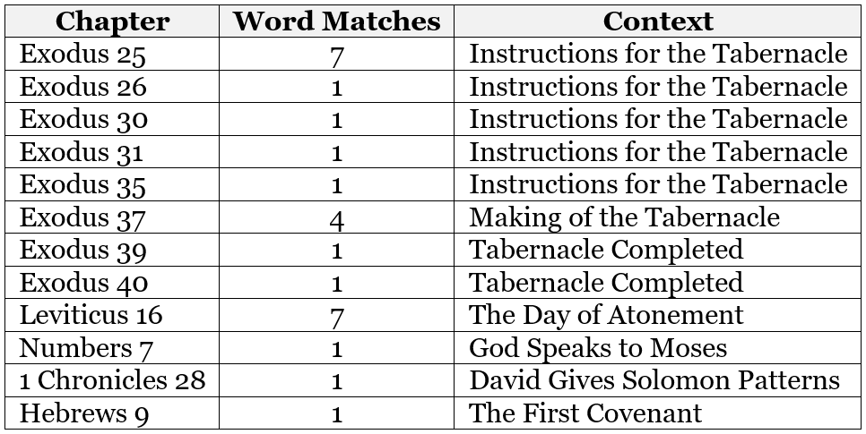

Slide 5
Hebrews 9:3-5 And after the second veil, the tabernacle which is called the Holiest of all; 4 Which had the golden censer, and the ark of the covenant overlaid round about with gold, wherein was the golden pot that had manna, and Aaron's rod that budded, and the tables of the covenant; 5 And over it the cherubims of glory shadowing the mercyseat; of which we cannot now speak particularly.

Slide 6
Exodus 25:17-19 And thou shalt make a mercy seat of pure gold: two cubits and a half shall be the length thereof, and a cubit and a half the breadth thereof. 18 And thou shalt make two cherubims of gold, of beaten work shalt thou make them, in the two ends of the mercy seat. 19 And make one cherub on the one end, and the other cherub on the other end: even of the mercy seat shall ye make the cherubims on the two ends thereof.

Slide 7
Exodus 25:20-21 And the cherubims shall stretch forth their wings on high, covering the mercy seat with their wings, and their faces shall look one to another; toward the mercy seat shall the faces of the cherubims be. 21 And thou shalt put the mercy seat above upon the ark; and in the ark thou shalt put the testimony that I shall give thee.

Slide 8
Exodus 25:22 And there I will meet with thee, and I will commune with thee from above the mercy seat, from between the two cherubims which are upon the ark of the testimony, of all things which I will give thee in commandment unto the children of Israel.

Slide 9
Exodus 26:34 And thou shalt put the mercy seat upon the ark of the testimony in the most holy place.

Slide 10
Exodus 30:6 And thou shalt put it before the vail that is by the ark of the testimony, before the mercy seat that is over the testimony, where I will meet with thee.

Slide 11
Exodus 31:7 The tabernacle of the congregation, and the ark of the testimony, and the mercy seat that is thereupon, and all the furniture of the tabernacle

Slide 12
Exodus 35:10-12 And every wise hearted among you shall come, and make all that the LORD hath commanded; 11 The tabernacle, his tent, and his covering, his taches, and his boards, his bars, his pillars, and his sockets, 12 The ark, and the staves thereof, with the mercy seat, and the vail of the covering,

Slide 13
Exodus 37:6-7 And he made the mercy seat of pure gold: two cubits and a half was the length thereof, and one cubit and a half the breadth thereof. 7 And he made two cherubims of gold, beaten out of one piece made he them, on the two ends of the mercy seat;

Slide 14
Exodus 37:8-9 One cherub on the end on this side, and another cherub on the other end on that side: out of the mercy seat made he the cherubims on the two ends thereof. 9 And the cherubims spread out their wings on high, and covered with their wings over the mercy seat, with their faces one to another; even to the mercy seatward were the faces of the cherubims.

Slide 15
Exodus 39:35 The ark of the testimony, and the staves thereof, and the mercy seat,

Slide 16
Exodus 40:18-20 And Moses reared up the tabernacle, and fastened his sockets, and set up the boards thereof, and put in the bars thereof, and reared up his pillars. 19 And he spread abroad the tent over the tabernacle, and put the covering of the tent above upon it; as the LORD commanded Moses. 20 And he took and put the testimony into the ark, and set the staves on the ark, and put the mercy seat above upon the ark:

Slide 17
Leviticus 16:2 And the LORD said unto Moses, Speak unto Aaron thy brother, that he come not at all times into the holy place within the vail before the mercy seat, which is upon the ark; that he die not: for I will appear in the cloud upon the mercy seat.

Slide 18
Leviticus 16:13 And he shall put the incense upon the fire before the LORD, that the cloud of the incense may cover the mercy seat that is upon the testimony, that he die not:

Slide 19
Leviticus 16:14 And he shall take of the blood of the bullock, and sprinkle it with his finger upon the mercy seat eastward; and before the mercy seat shall he sprinkle of the blood with his finger seven times.

Slide 20
Leviticus 16:15 Then shall he kill the goat of the sin offering, that is for the people, and bring his blood within the vail, and do with that blood as he did with the blood of the bullock, and sprinkle it upon the mercy seat, and before the mercy seat:

Slide 21
Numbers 7:89 And when Moses was gone into the tabernacle of the congregation to speak with him, then he heard the voice of one speaking unto him from off the mercy seat that was upon the ark of testimony, from between the two cherubims: and he spake unto him.

Slide 22
1 Chronicles 28:11-12 Then David gave to Solomon his son the pattern of the porch, and of the houses thereof, and of the treasuries thereof, and of the upper chambers thereof, and of the inner parlours thereof, and of the place of the mercy seat, 12 And the pattern of all that he had by the spirit, of the courts of the house of the LORD, and of all the chambers round about, of the treasuries of the house of God, and of the treasuries of the dedicated things:

Slide 23
Hebrews 9:1-3 Then verily the first covenant had also ordinances of divine service, and a worldly sanctuary. 2 For there was a tabernacle made; the first, wherein was the candlestick, and the table, and the shewbread; which is called the sanctuary. 3 And after the second veil, the tabernacle which is called the Holiest of all;

Slide 24
Hebrews 9:4-5 Which had the golden censer, and the ark of the covenant overlaid round about with gold, wherein was the golden pot that had manna, and Aaron's rod that budded, and the tables of the covenant; 5 And over it the cherubims of glory shadowing the mercyseat; of which we cannot now speak particularly.

Slide 25
Acts 17:11 These were more noble than those in Thessalonica, in that they received the word with all readiness of mind, and searched the scriptures daily, whether those things were so.

Slide 26
Romans 12:9 Let love be without dissimulation. Abhor that which is evil; cleave to that which is good.

Slide 27
Visit Us:
TrueWordsBaptist.org
True Words Baptist Church – 1377 S. 20th St. Louisville, KY – TrueWordsBaptist.org

