Slide 1

Sunday School
Matthew 4:8-10
Joshua Tapp
True Words Baptist Church – 1377 S. 20th St. Louisville, KY – TrueWordsBaptist.org

Slide 2
Title of the Lesson:
Fall Down and Worship Me
True Words Baptist Church – 1377 S. 20th St. Louisville, KY – TrueWordsBaptist.org

Slide 3
Matthew 4:8-10 Again, the devil taketh him up into an exceeding high mountain, and sheweth him all the kingdoms of the world, and the glory of them; 9 And saith unto him, All these things will I give thee, if thou wilt fall down and worship me. 10 Then saith Jesus unto him, Get thee hence, Satan: for it is written, Thou shalt worship the Lord thy God, and him only shalt thou serve.

Slide 4
Matthew 23:5-7 But all their works they do for to be seen of men: they make broad their phylacteries, and enlarge the borders of their garments, 6 And love the uppermost rooms at feasts, and the chief seats in the synagogues, 7 And greetings in the markets, and to be called of men, Rabbi, Rabbi.

Slide 5
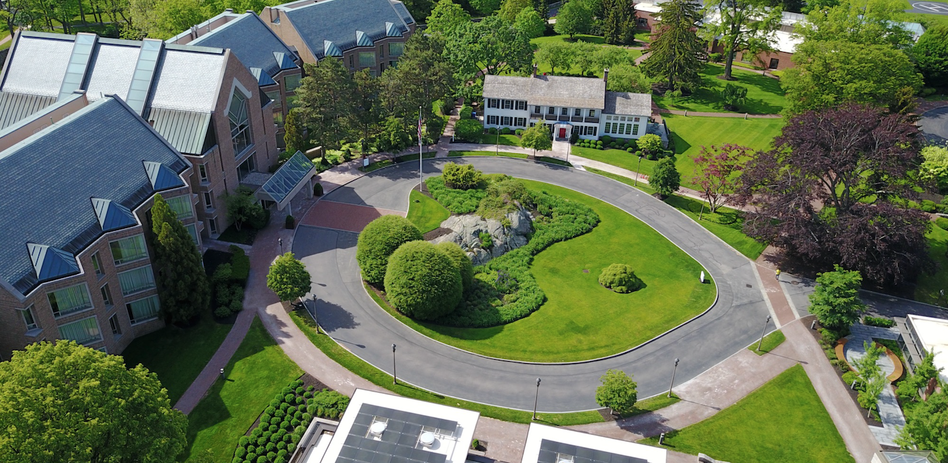

Slide 6
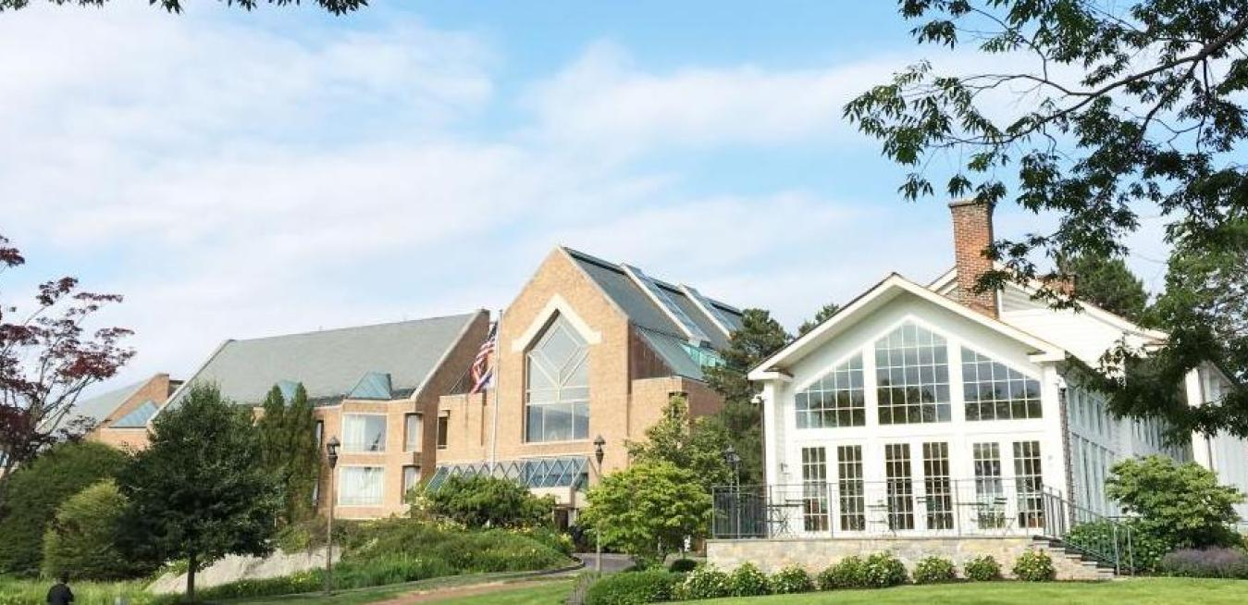

Slide 7
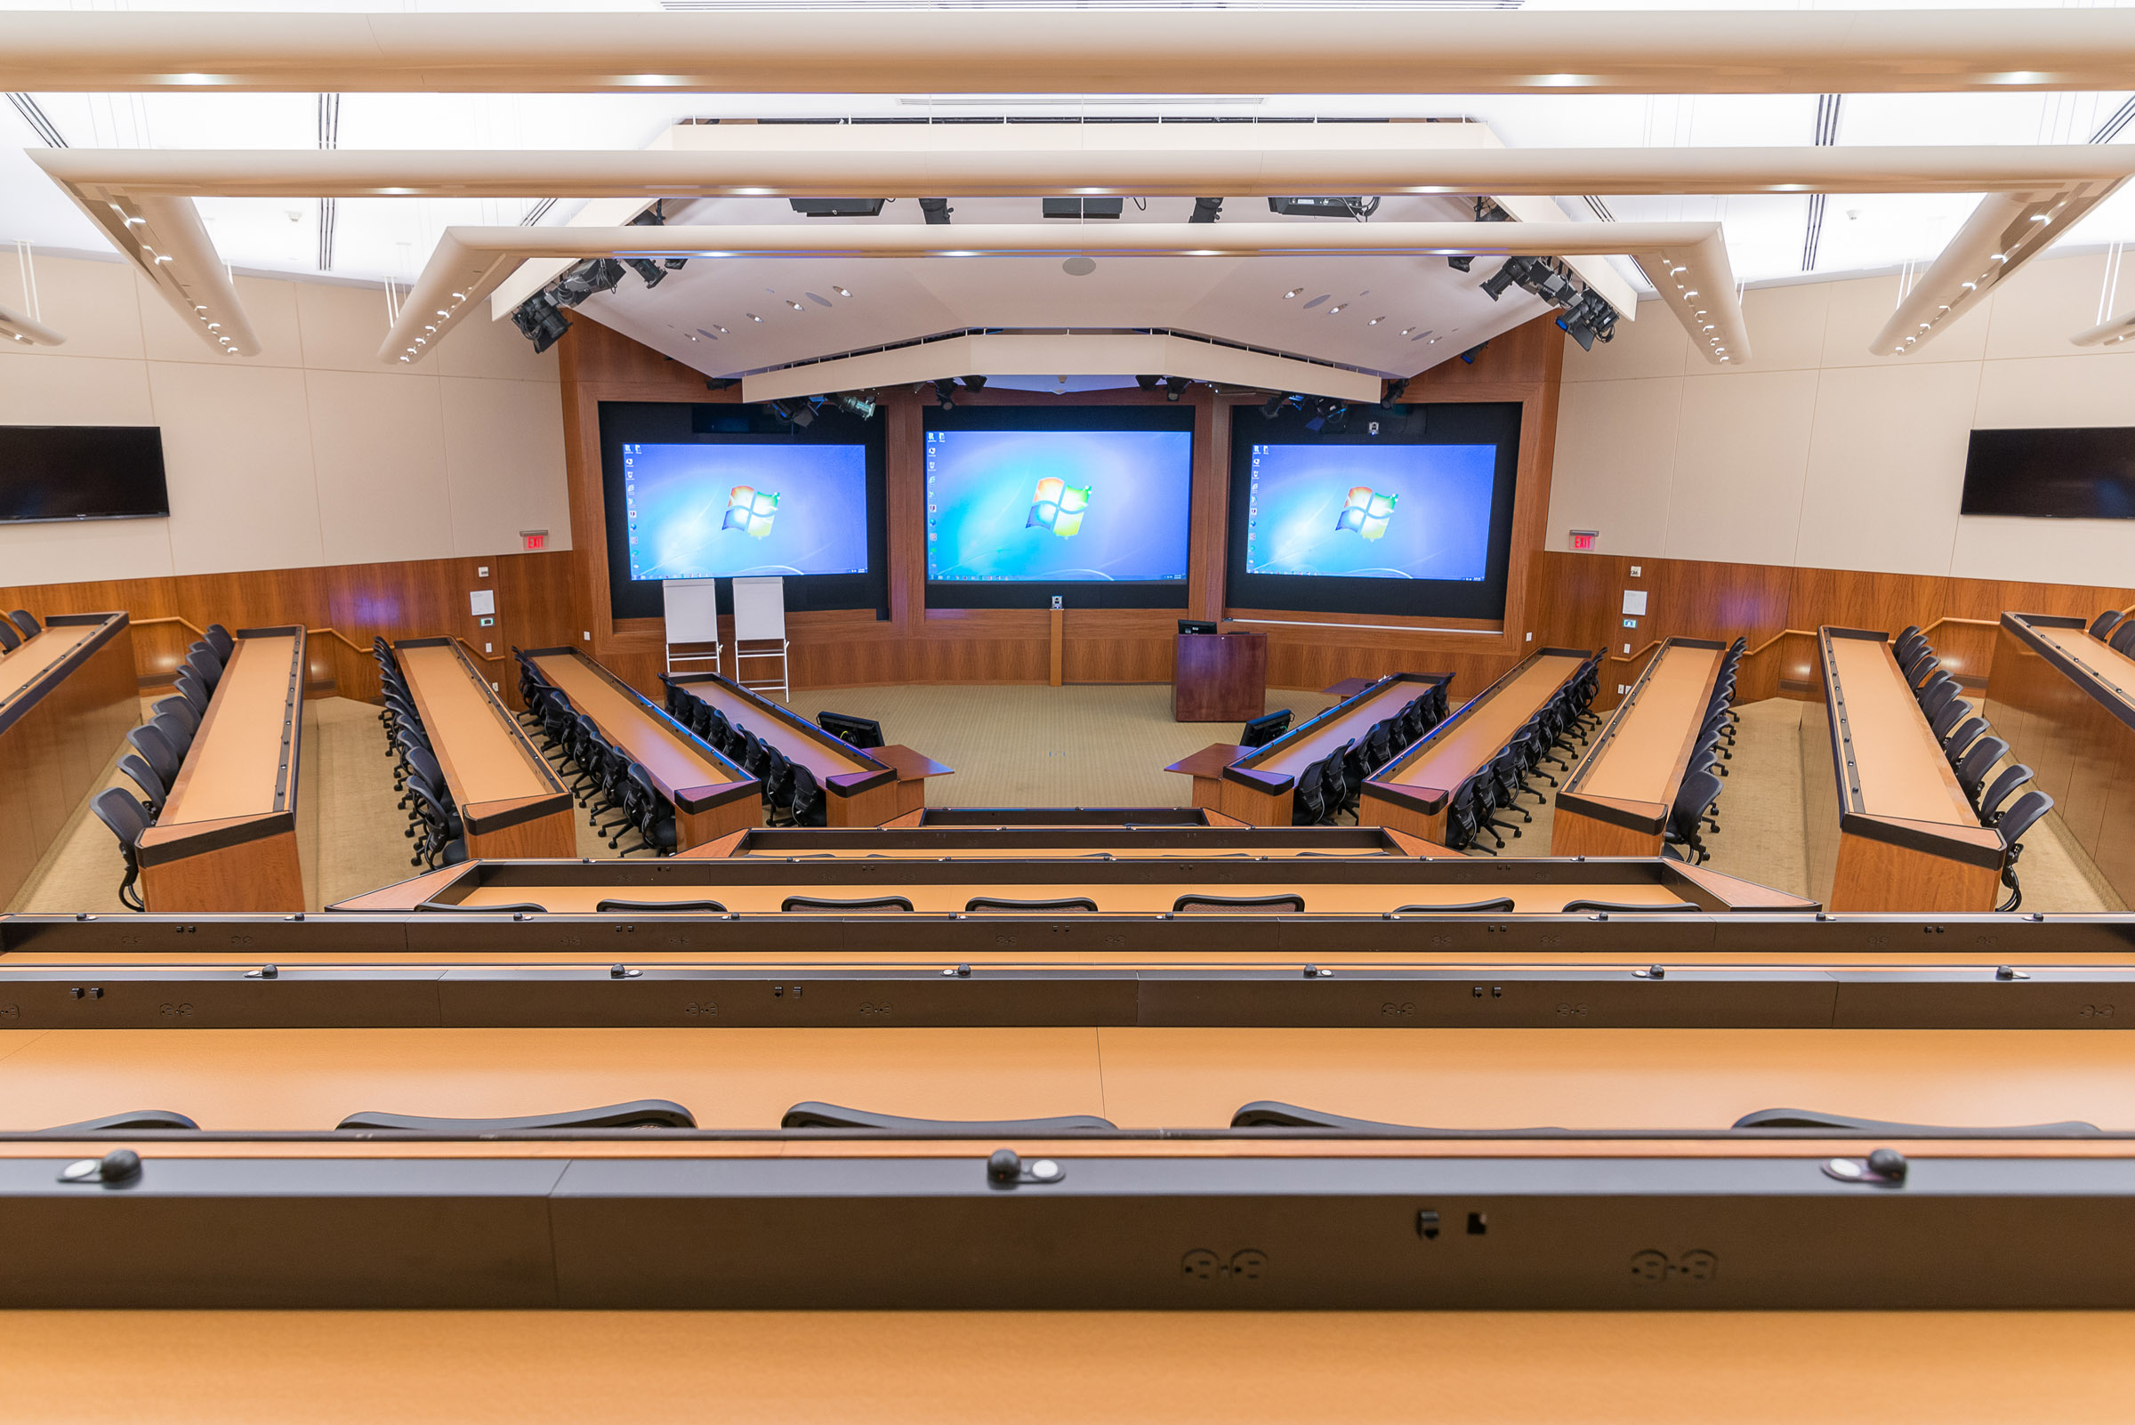

Slide 8
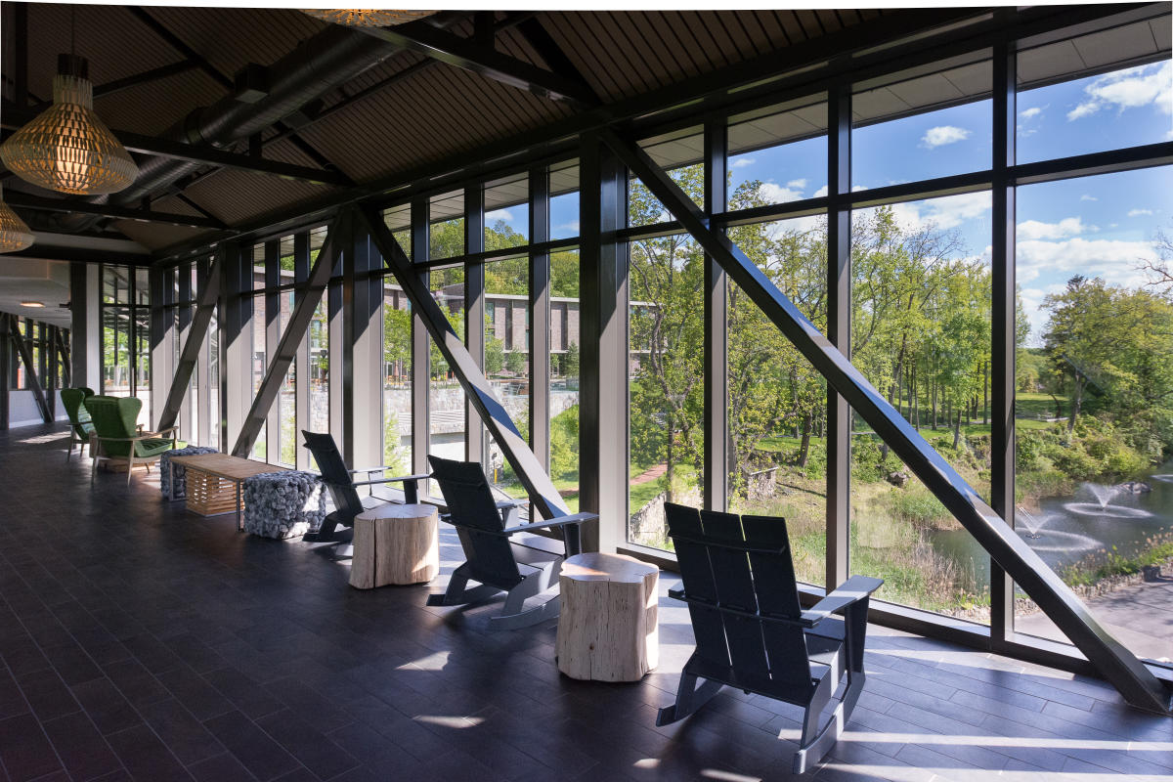

Slide 9
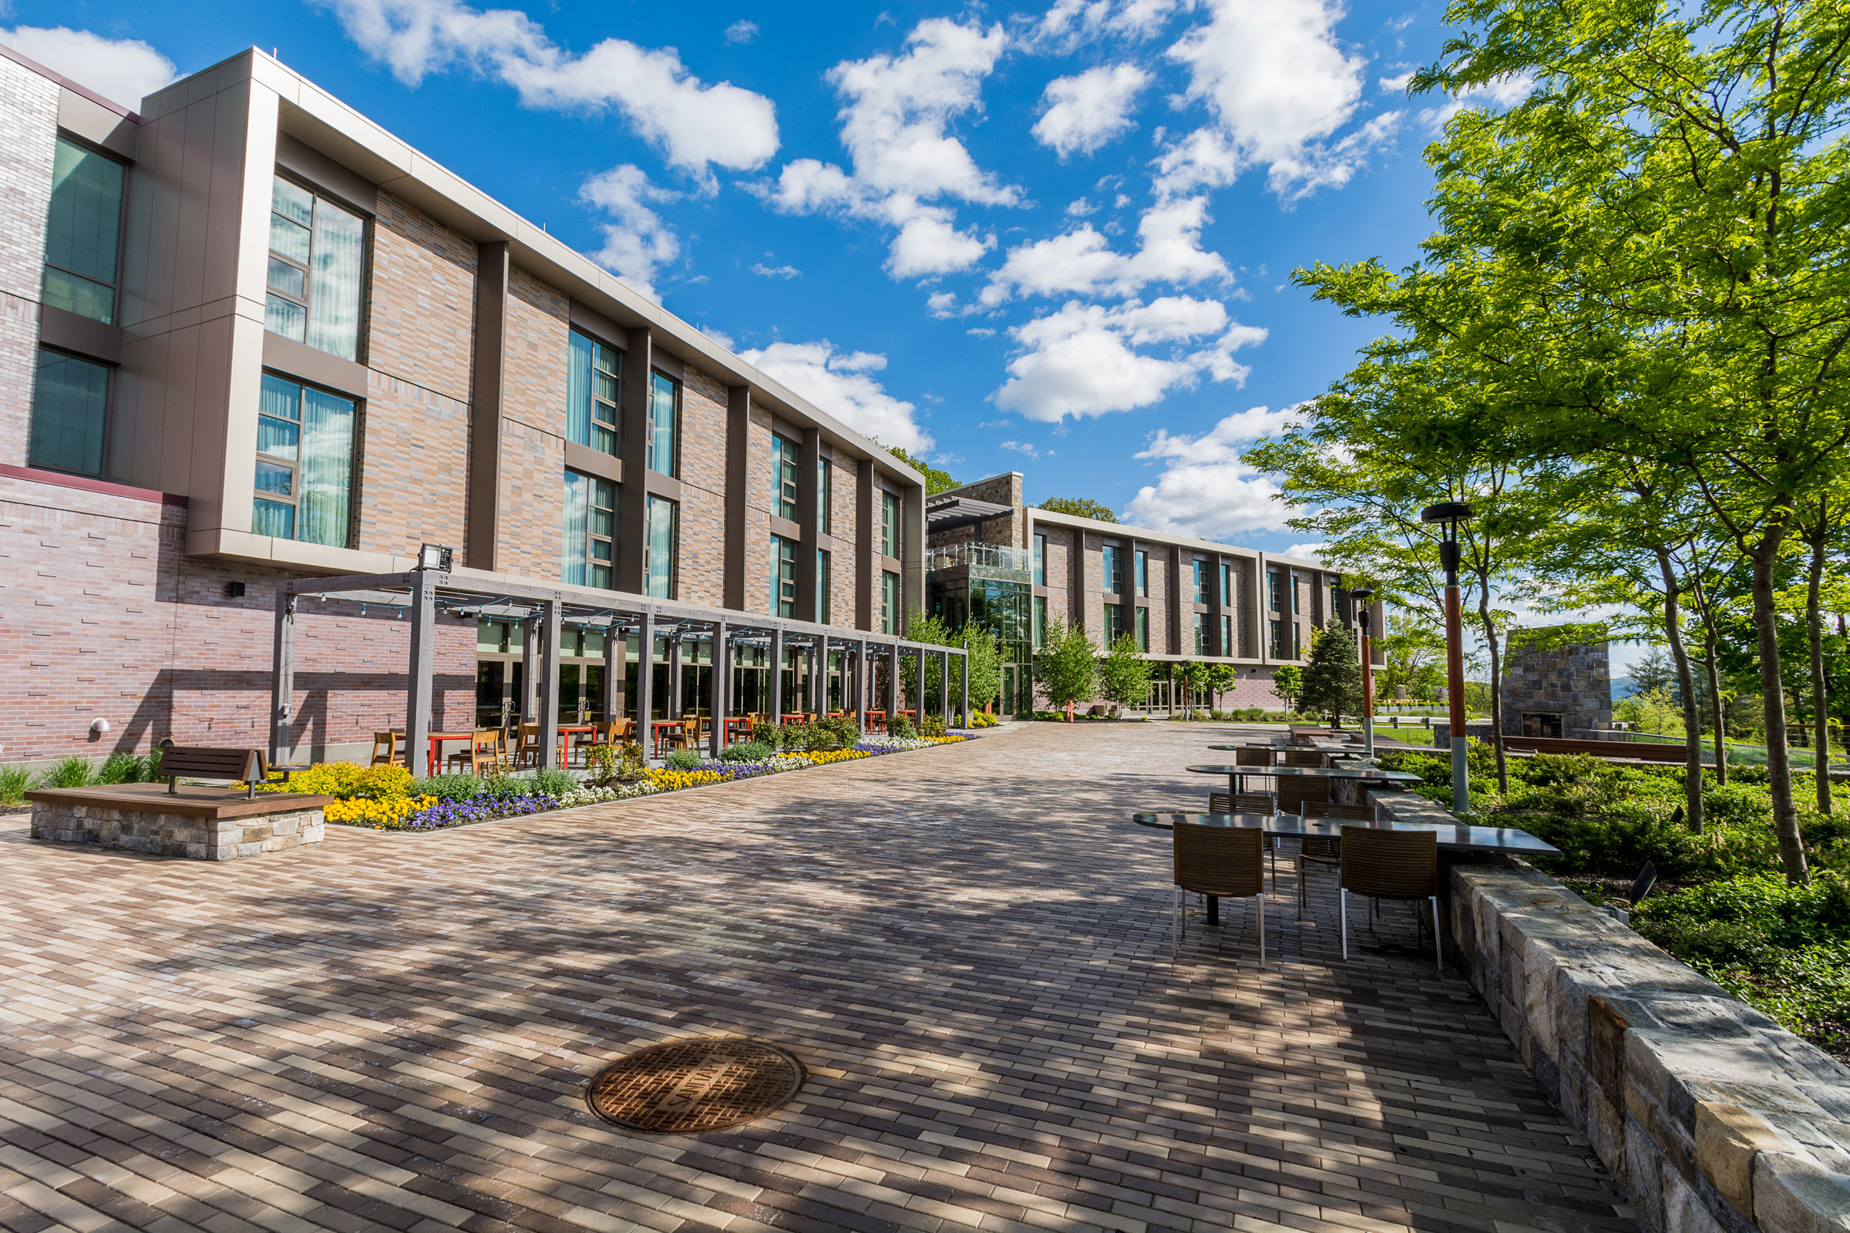

Slide 10
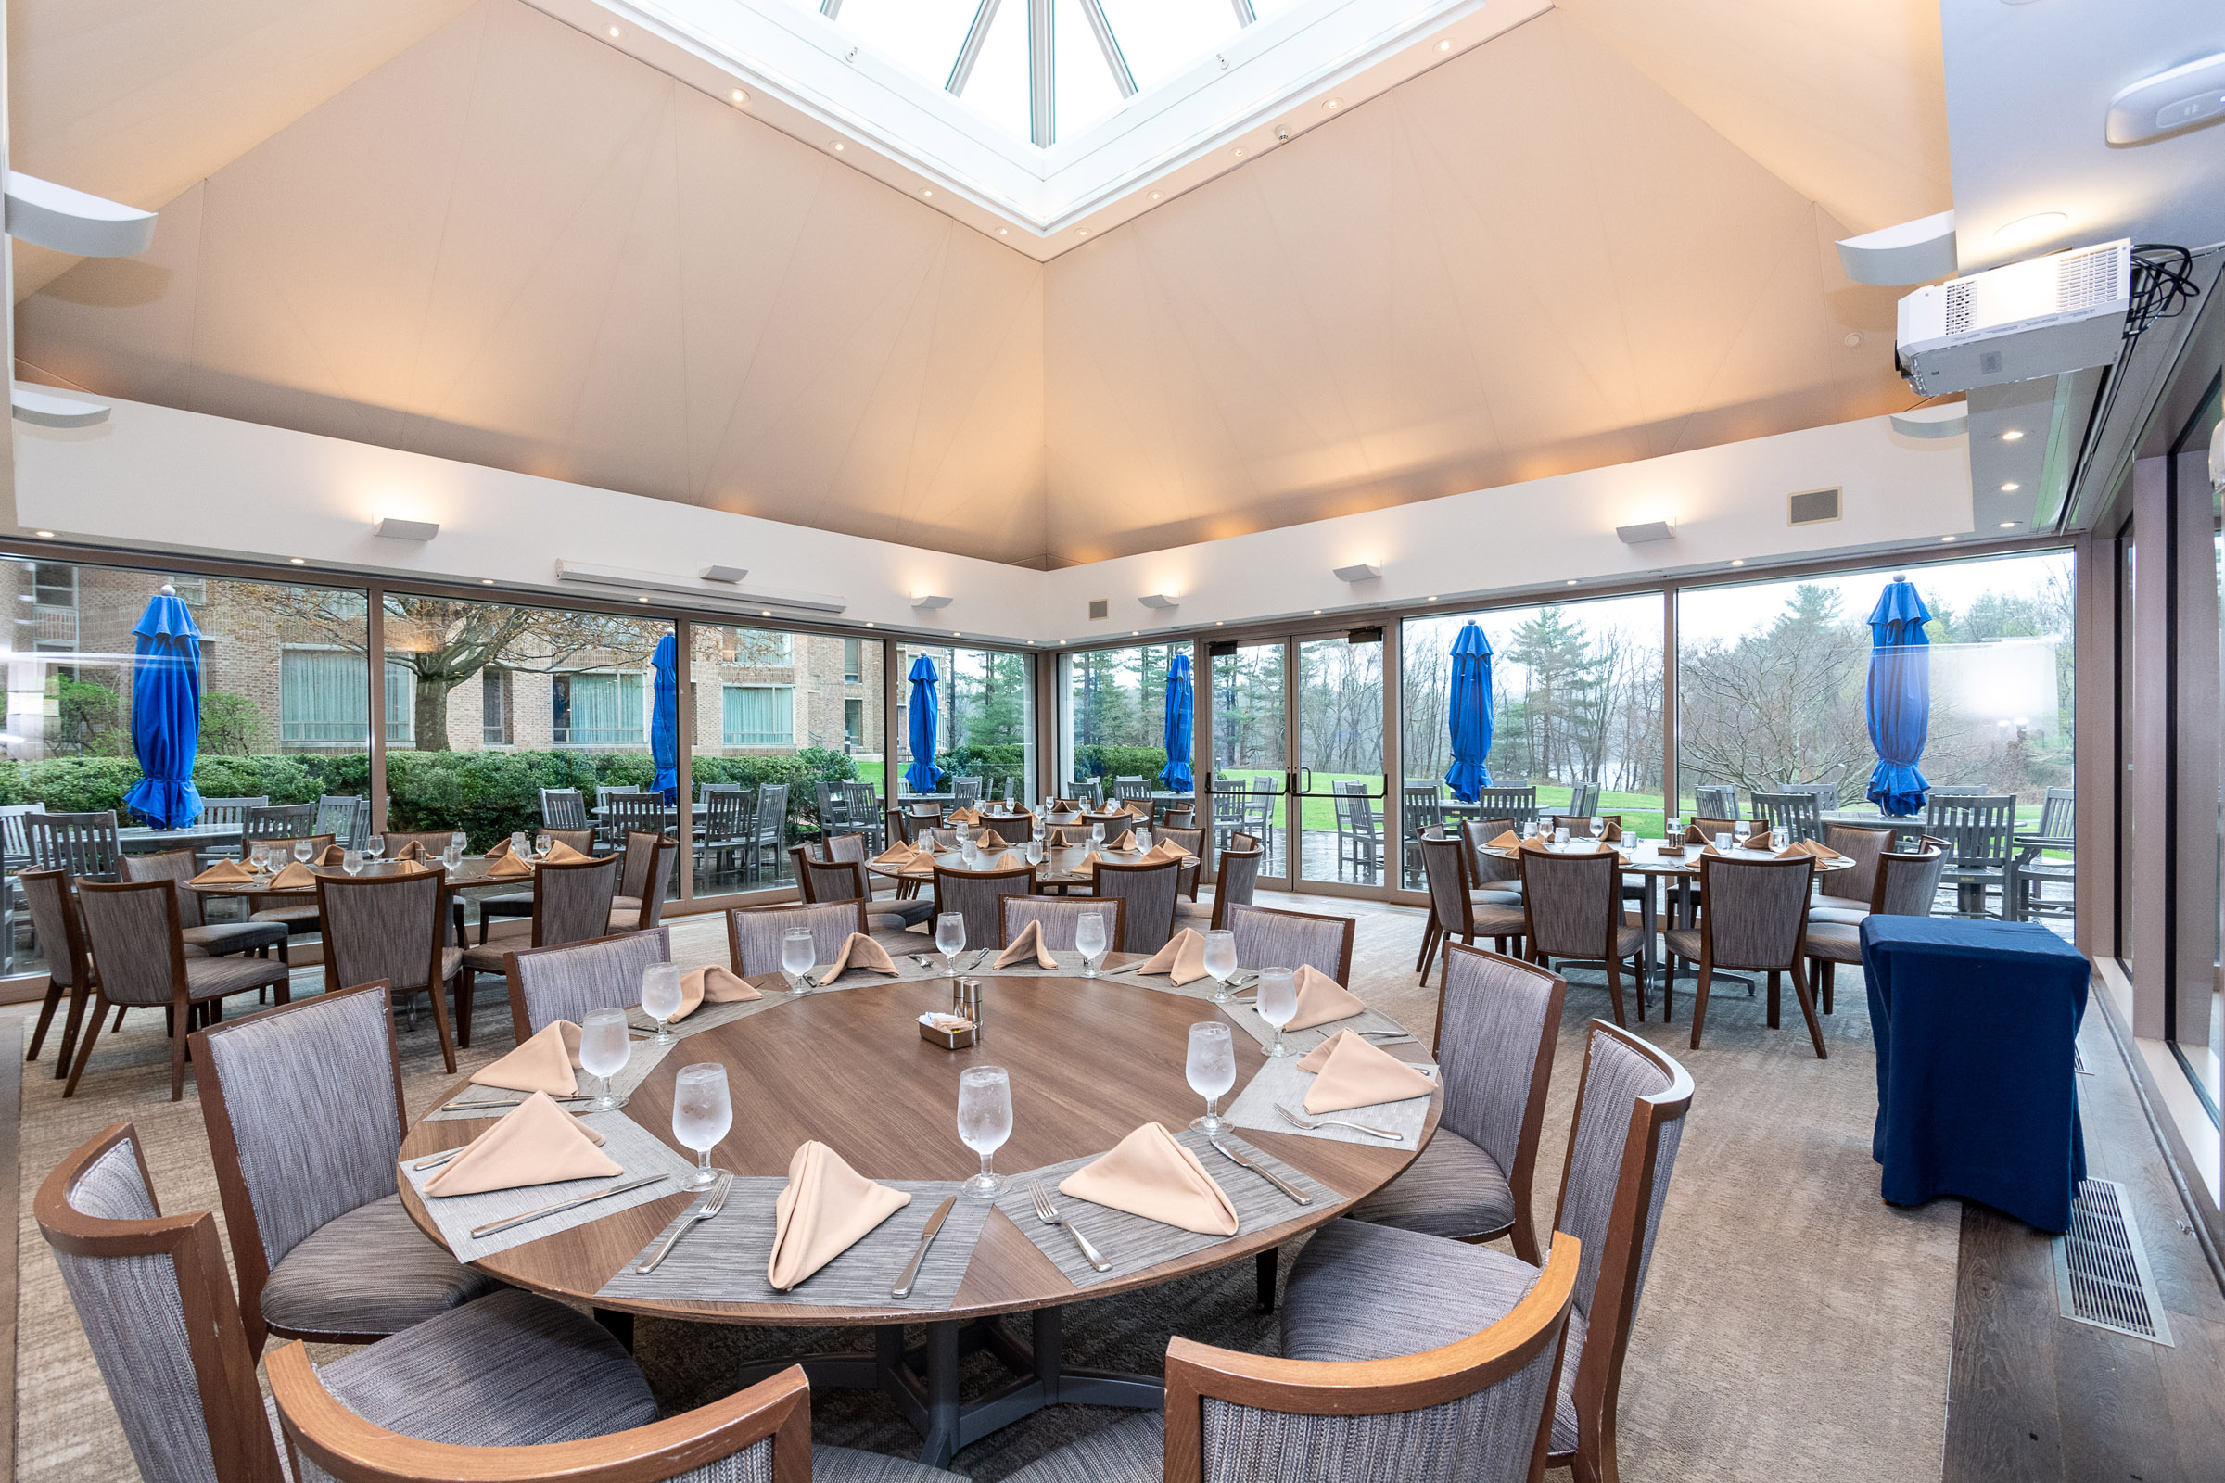

Slide 11
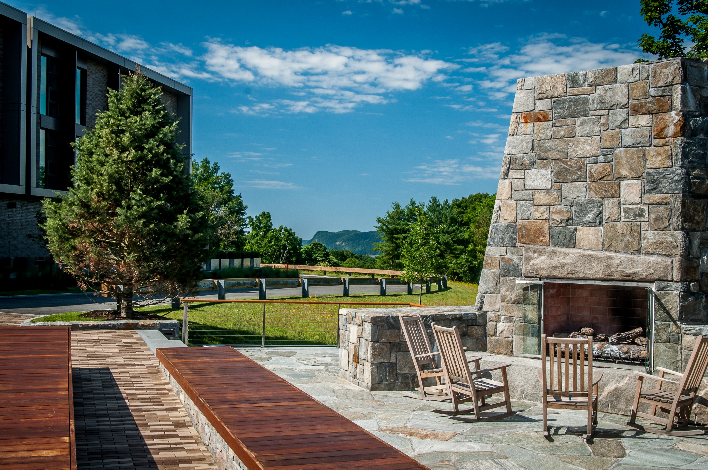

Slide 12


Slide 13
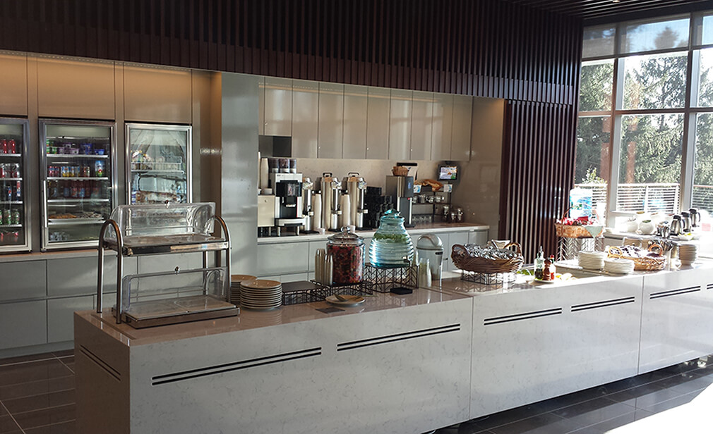

Slide 14
Matthew 4:8 Again, the devil taketh him up into an exceeding high mountain, and sheweth him all the kingdoms of the world, and the glory of them;

Slide 15


Slide 16
Matthew 4:9 And saith unto him, All these things will I give thee, if thou wilt fall down and worship me.

Slide 17
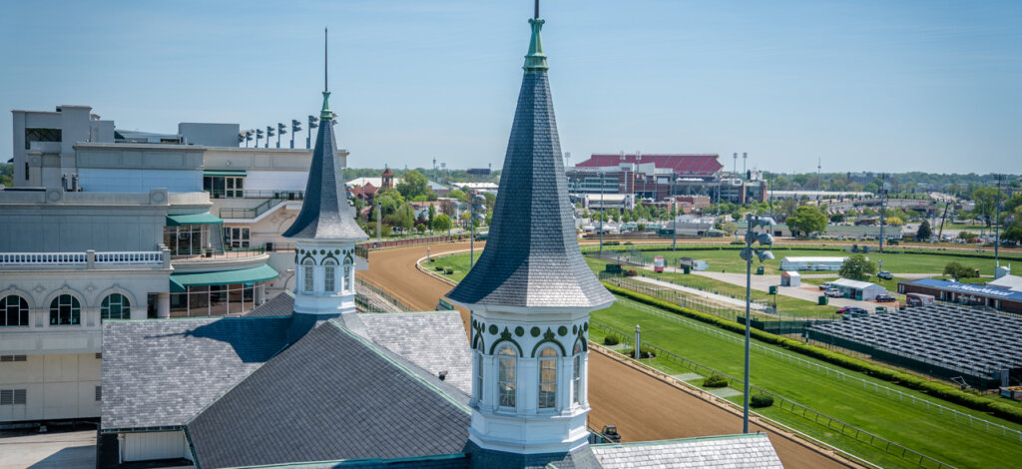

Slide 18
Matthew 4:10 Then saith Jesus unto him, Get thee hence, Satan: for it is written, Thou shalt worship the Lord thy God, and him only shalt thou serve.

Slide 19
Visit Us:
TrueWordsBaptist.org
True Words Baptist Church – 1377 S. 20th St. Louisville, KY – TrueWordsBaptist.org

