Slide 1

Thursday Bible Study
Leviticus 23
Joshua Tapp
True Words Baptist Church – 1377 S. 20th St. Louisville, KY – TrueWordsBaptist.org

Slide 2
Title of the Bible Study:
The Feast of Firstfruits
True Words Baptist Church – 1377 S. 20th St. Louisville, KY – TrueWordsBaptist.org

Slide 3
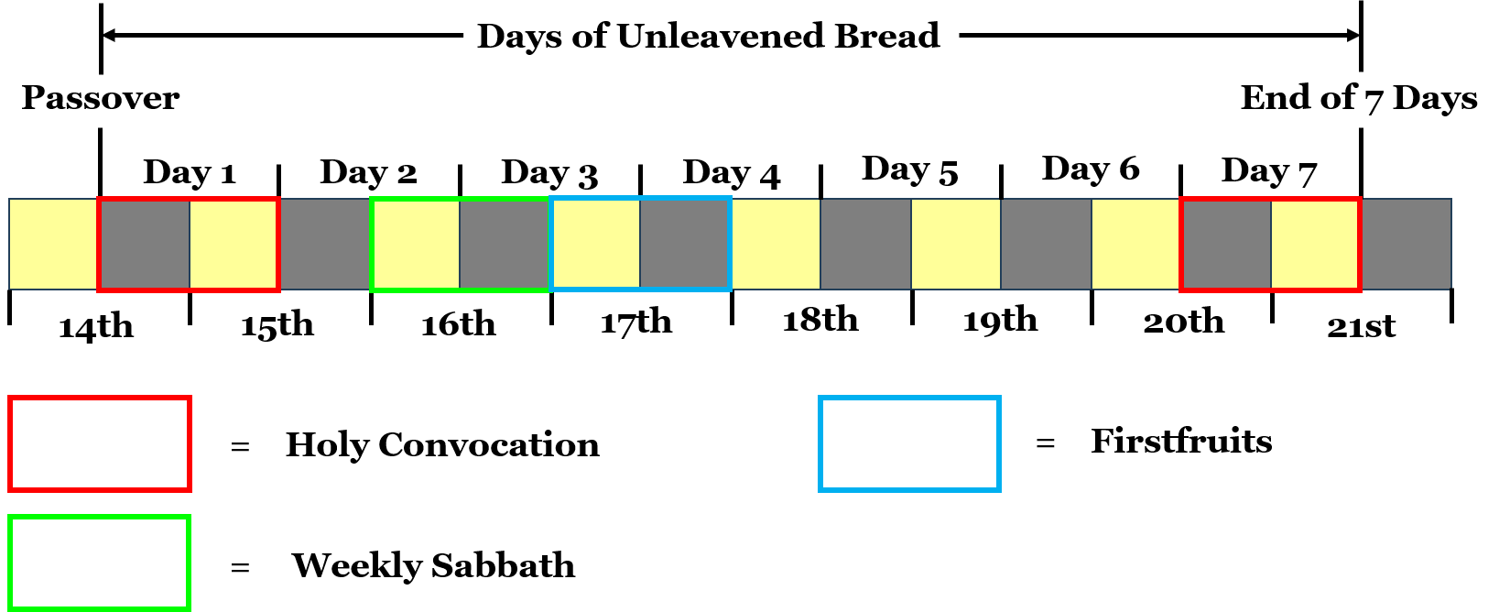

Slide 4
Leviticus 23:10-11 Speak unto the children of Israel, and say unto them, When ye be come into the land which I give unto you, and shall reap the harvest thereof, then ye shall bring a sheaf of the firstfruits of your harvest unto the priest: 11 And he shall wave the sheaf before the LORD, to be accepted for you: on the morrow after the sabbath the priest shall wave it.

Slide 5


Slide 6
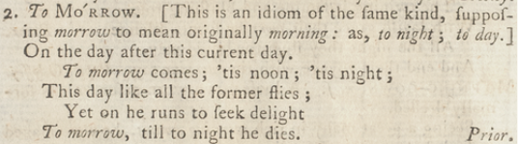

Slide 7
Matthew 28:1 In the end of the sabbath, as it began to dawn toward the first day of the week, came Mary Magdalene and the other Mary to see the sepulchre.

Slide 8
Mark 16:1-2 And when the sabbath was past, Mary Magdalene, and Mary the mother of James, and Salome, had bought sweet spices, that they might come and anoint him. 2 And very early in the morning the first day of the week, they came unto the sepulchre at the rising of the sun.

Slide 9
1 Corinthians 15:20 But now is Christ risen from the dead, and become the firstfruits of them that slept.

Slide 10
Leviticus 23:10-11 Speak unto the children of Israel, and say unto them, When ye be come into the land which I give unto you, and shall reap the harvest thereof, then ye shall bring a sheaf of the firstfruits of your harvest unto the priest: 11 And he shall wave the sheaf before the LORD, to be accepted for you: on the morrow after the sabbath the priest shall wave it.

Slide 11
Exodus 16:22-23 And it came to pass, that on the sixth day they gathered twice as much bread, two omers for one man: and all the rulers of the congregation came and told Moses. 23 And he said unto them, This is that which the LORD hath said, To morrow is the rest of the holy sabbath unto the LORD: bake that which ye will bake to day, and seethe that ye will seethe; and that which remaineth over lay up for you to be kept until the morning.

Slide 12
Exodus 16:24-26 And they laid it up till the morning, as Moses bade: and it did not stink, neither was there any worm therein. 25 And Moses said, Eat that to day; for to day is a sabbath unto the LORD: to day ye shall not find it in the field. 26 Six days ye shall gather it; but on the seventh day, which is the sabbath, in it there shall be none.

Slide 14
Visit Us:
TrueWordsBaptist.org
True Words Baptist Church – 1377 S. 20th St. Louisville, KY – TrueWordsBaptist.org

