Slide 1

Sunday Morning
James 2
Joshua Tapp
True Words Baptist Church – 1377 S. 20th St. Louisville, KY – TrueWordsBaptist.org

Slide 2
Title of the Sermon
The Devils
Also Believe
True Words Baptist Church – 1377 S. 20th St. Louisville, KY – TrueWordsBaptist.org

Slide 3
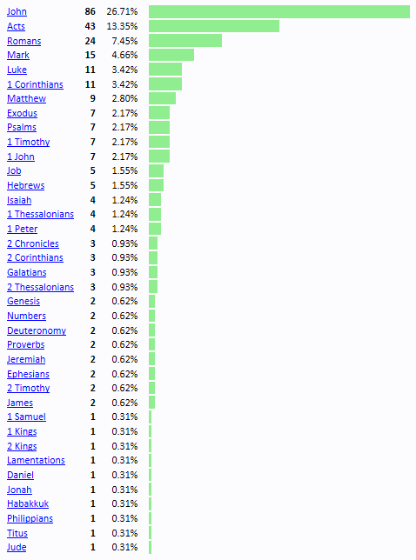
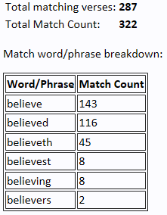

Slide 4
John 20:31 But these are written, that ye might believe that Jesus is the Christ, the Son of God; and that believing ye might have life through his name.

Slide 5
John 3:15 That whosoever believeth in him should not perish, but have eternal life.

Slide 6
John 3:16 For God so loved the world, that he gave his only begotten Son, that whosoever believeth in him should not perish, but have everlasting life.

Slide 7
John 3:18 He that believeth on him is not condemned: but he that believeth not is condemned already, because he hath not believed in the name of the only begotten Son of God.

Slide 8
John 3:36 He that believeth on the Son hath everlasting life: and he that believeth not the Son shall not see life; but the wrath of God abideth on him.

Slide 9
John 5:24 Verily, verily, I say unto you, He that heareth my word, and believeth on him that sent me, hath everlasting life, and shall not come into condemnation; but is passed from death unto life.

Slide 10
John 6:35 And Jesus said unto them, I am the bread of life: he that cometh to me shall never hunger; and he that believeth on me shall never thirst.

Slide 11
John 6:40 And this is the will of him that sent me, that every one which seeth the Son, and believeth on him, may have everlasting life: and I will raise him up at the last day.

Slide 12
John 6:47 Verily, verily, I say unto you, He that believeth on me hath everlasting life.

Slide 13
John 11:25-26 Jesus said unto her, I am the resurrection, and the life: he that believeth in me, though he were dead, yet shall he live: 26 And whosoever liveth and believeth in me shall never die. Believest thou this?

Slide 14
Acts 10:43 To him give all the prophets witness, that through his name whosoever believeth in him shall receive remission of sins.

Slide 15
Acts 13:39 And by him all that believe are justified from all things, from which ye could not be justified by the law of Moses.

Slide 16
Acts 13:48 And when the Gentiles heard this, they were glad, and glorified the word of the Lord: and as many as were ordained to eternal life believed.

Slide 17
Acts 15:11 But we believe that through the grace of the Lord Jesus Christ we shall be saved, even as they.

Slide 18
Acts 16:31 And they said, Believe on the Lord Jesus Christ, and thou shalt be saved, and thy house.

Slide 19
James 2:19 Thou believest that there is one God; thou doest well: the devils also believe, and tremble.

Slide 20
Hebrews 1:8 But unto the Son he saith, Thy throne, O God, is for ever and ever: a sceptre of righteousness is the sceptre of thy kingdom.

Slide 21
Matthew 8:28-29 And when he was come to the other side into the country of the Gergesenes, there met him two possessed with devils, coming out of the tombs, exceeding fierce, so that no man might pass by that way. 29 And, behold, they cried out, saying, What have we to do with thee, Jesus, thou Son of God? art thou come hither to torment us before the time?

Slide 22
Luke 8:27-28 And when he went forth to land, there met him out of the city a certain man, which had devils long time, and ware no clothes, neither abode in any house, but in the tombs. 28 When he saw Jesus, he cried out, and fell down before him, and with a loud voice said, What have I to do with thee, Jesus, thou Son of God most high? I beseech thee, torment me not.

Slide 23
Matthew 25:41 Then shall he say also unto them on the left hand, Depart from me, ye cursed, into everlasting fire, prepared for the devil and his angels:

Slide 24
Hebrews 2:14-16 Forasmuch then as the children are partakers of flesh and blood, he also himself likewise took part of the same; that through death he might destroy him that had the power of death, that is, the devil; 15 And deliver them who through fear of death were all their lifetime subject to bondage. 16 For verily he took not on him the nature of angels; but he took on him the seed of Abraham.

Slide 25
Hebrews 2:17 Wherefore in all things it behoved him to be made like unto his brethren, that he might be a merciful and faithful high priest in things pertaining to God, to make reconciliation for the sins of the people.

Slide 26
Jude 6 And the angels which kept not their first estate, but left their own habitation, he hath reserved in everlasting chains under darkness unto the judgment of the great day.

Slide 27
1 John 5:10-13 He that believeth on the Son of God hath the witness in himself: he that believeth not God hath made him a liar; because he believeth not the record that God gave of his Son. 11 And this is the record, that God hath given to us eternal life, and this life is in his Son. 12 He that hath the Son hath life; and he that hath not the Son of God hath not life. 13 These things have I written unto you that believe on the name of the Son of God; that ye may know that ye have eternal life, and that ye may believe on the name of the Son of God.

Slide 28
Visit Us:
TrueWordsBaptist.org
True Words Baptist Church – 1377 S. 20th St. Louisville, KY – TrueWordsBaptist.org

