Slide 1

Thursday Bible Study
Exodus 12
Joshua Tapp
True Words Baptist Church – 1377 S. 20th St. Louisville, KY – TrueWordsBaptist.org

Slide 2
Title of the Bible Study:
The Passover
Timeline
True Words Baptist Church – 1377 S. 20th St. Louisville, KY – TrueWordsBaptist.org

Slide 3
Genesis 22:8 And Abraham said, My son, God will provide himself a lamb for a burnt offering: so they went both of them together.

Slide 4
Isaiah 53:7 He was oppressed, and he was afflicted, yet he opened not his mouth: he is brought as a lamb to the slaughter, and as a sheep before her shearers is dumb, so he openeth not his mouth.

Slide 5
1 Peter 1:19 But with the precious blood of Christ, as of a lamb without blemish and without spot:

Slide 6
Matthew 27:34 They gave him vinegar to drink mingled with gall: and when he had tasted thereof, he would not drink.

Slide 7
Exodus 12:46 In one house shall it be eaten; thou shalt not carry forth ought of the flesh abroad out of the house; neither shall ye break a bone thereof.

Slide 8
John 19:32-36 Then came the soldiers, and brake the legs of the first, and of the other which was crucified with him. 33 But when they came to Jesus, and saw that he was dead already, they brake not his legs: 34 But one of the soldiers with a spear pierced his side, and forthwith came there out blood and water. 35 And he that saw it bare record, and his record is true: and he knoweth that he saith true, that ye might believe. 36 For these things were done, that the scripture should be fulfilled, A bone of him shall not be broken.

Slide 9
Psalm 34:20 He keepeth all his bones: not one of them is broken.

Slide 10
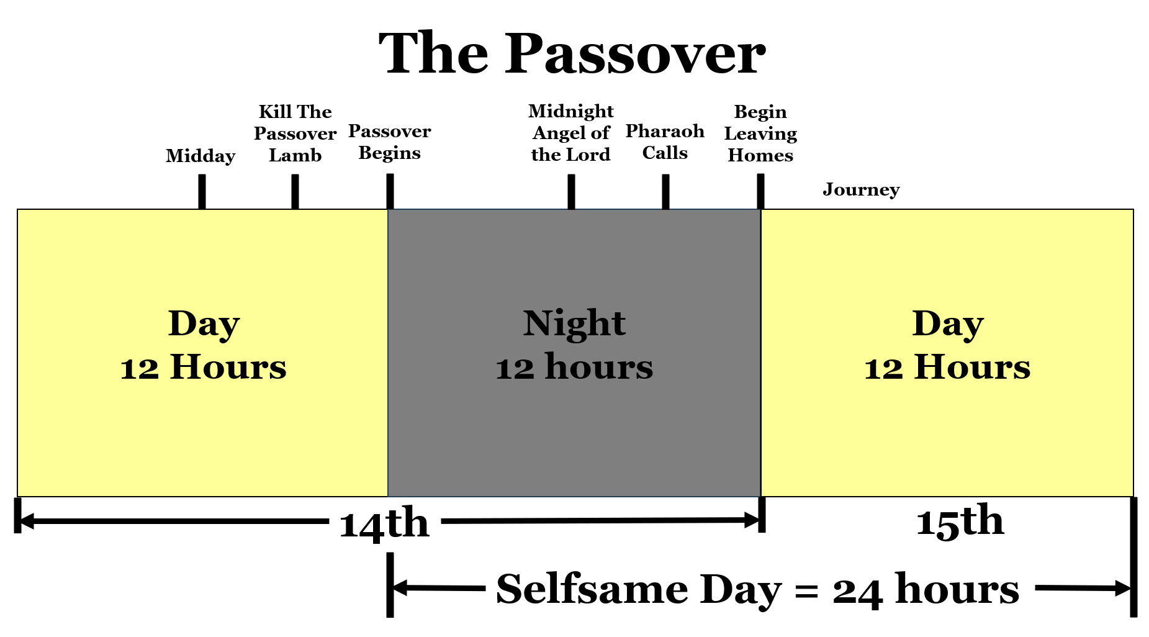

Slide 11
John 19:31 The Jews therefore, because it was the preparation, that the bodies should not remain upon the cross on the sabbath day, (for that sabbath day was an high day,) besought Pilate that their legs might be broken, and that they might be taken away.

Slide 13
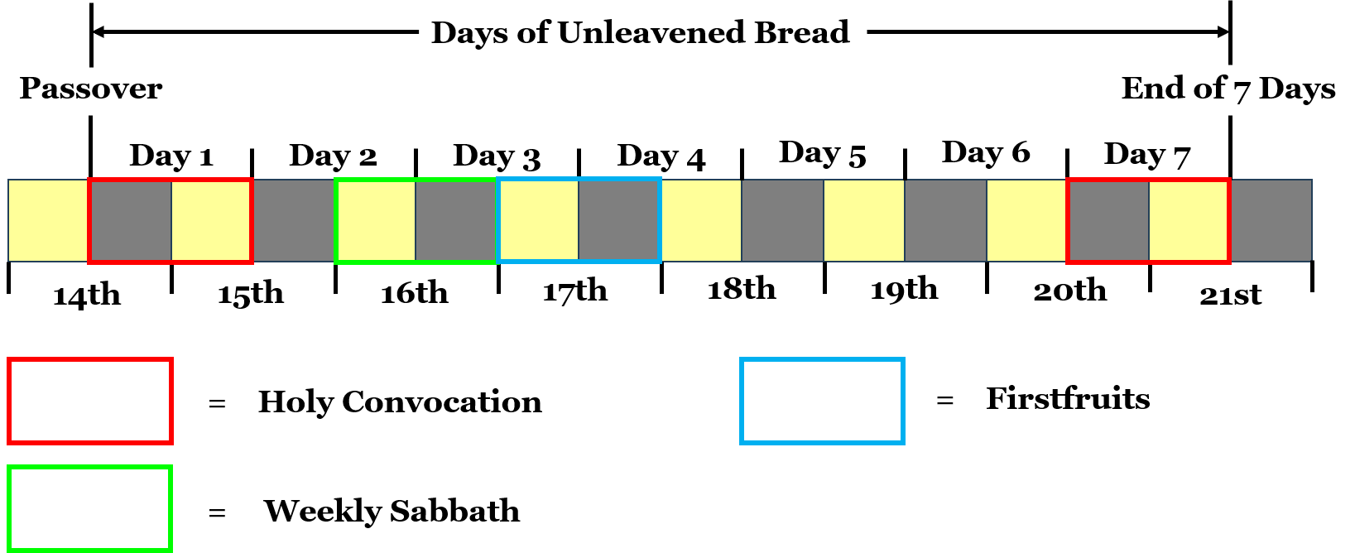

Slide 14
Visit Us:
TrueWordsBaptist.org
True Words Baptist Church – 1377 S. 20th St. Louisville, KY – TrueWordsBaptist.org

