Slide 1

Sunday School
Matthew 1
Joshua Tapp
True Words Baptist Church – 1377 S. 20th St. Louisville, KY – TrueWordsBaptist.org

Slide 2
Title of the Lesson:
Cast Into A Land They Know Not
True Words Baptist Church – 1377 S. 20th St. Louisville, KY – TrueWordsBaptist.org

Slide 3
Matthew 1:12 And after they were brought to Babylon, Jechonias begat Salathiel; and Salathiel begat Zorobabel;

Slide 4
Ezra 5:2 Then rose up Zerubbabel the son of Shealtiel, and Jeshua the son of Jozadak, and began to build the house of God which is at Jerusalem: and with them were the prophets of God helping them.

Slide 5
Haggai 1:14-15 And the LORD stirred up the spirit of Zerubbabel the son of Shealtiel, governor of Judah, and the spirit of Joshua the son of Josedech, the high priest, and the spirit of all the remnant of the people; and they came and did work in the house of the LORD of hosts, their God, 15 In the four and twentieth day of the sixth month, in the second year of Darius the king.

Slide 6
Matthew 1:13-15 And Zorobabel begat Abiud; and Abiud begat Eliakim; and Eliakim begat Azor; 14 And Azor begat Sadoc; and Sadoc begat Achim; and Achim begat Eliud; 15 And Eliud begat Eleazar; and Eleazar begat Matthan; and Matthan begat Jacob;

Slide 7
Jeremiah 22:28-30 Is this man Coniah a despised broken idol? is he a vessel wherein is no pleasure? wherefore are they cast out, he and his seed, and are cast into a land which they know not? 29 O earth, earth, earth, hear the word of the LORD. 30 Thus saith the LORD, Write ye this man childless, a man that shall not prosper in his days: for no man of his seed shall prosper, sitting upon the throne of David, and ruling any more in Judah.

Slide 8
Matthew 1:15-16 And Eliud begat Eleazar; and Eleazar begat Matthan; and Matthan begat Jacob; 16 And Jacob begat Joseph the husband of Mary, of whom was born Jesus, who is called Christ.

Slide 9
Jeremiah 25:4-5 And the LORD hath sent unto you all his servants the prophets, rising early and sending them; but ye have not hearkened, nor inclined your ear to hear. 5 They said, Turn ye again now every one from his evil way, and from the evil of your doings, and dwell in the land that the LORD hath given unto you and to your fathers for ever and ever:

Slide 10
Jeremiah 25:6-7 And go not after other gods to serve them, and to worship them, and provoke me not to anger with the works of your hands; and I will do you no hurt. 7 Yet ye have not hearkened unto me, saith the LORD; that ye might provoke me to anger with the works of your hands to your own hurt.

Slide 11
Matthew 1:16 And Jacob begat Joseph the husband of Mary, of whom was born Jesus, who is called Christ.

Slide 12
Matthew 1:17 So all the generations from Abraham to David are fourteen generations; and from David until the carrying away into Babylon are fourteen generations; and from the carrying away into Babylon unto Christ are fourteen generations.

Slide 13
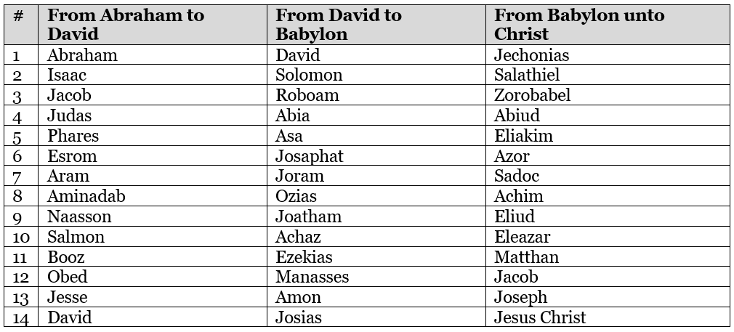

Slide 14
Visit Us:
TrueWordsBaptist.org
True Words Baptist Church – 1377 S. 20th St. Louisville, KY – TrueWordsBaptist.org

