Slide 1

Sunday Evening
Romans 5
Joshua Tapp
True Words Baptist Church – 1377 S. 20th St. Louisville, KY – TrueWordsBaptist.org

Slide 2
Title of the Sermon:
The Gospel
Introduction
True Words Baptist Church – 1377 S. 20th St. Louisville, KY – TrueWordsBaptist.org

Slide 3
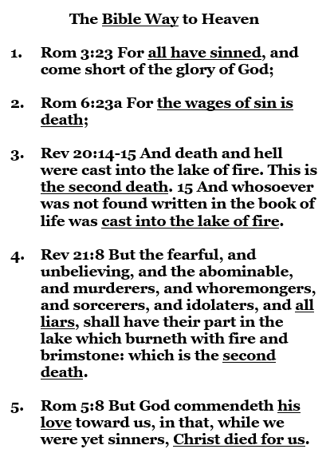
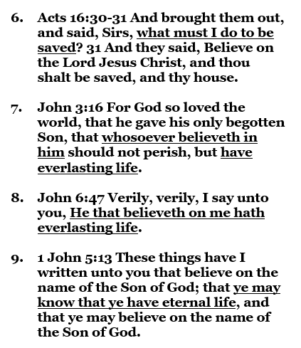

Slide 4
“Hello Sir, how you doing? My name is Josh. This is Nathan. We’re from a Baptist Church called True Words Baptist Church.”

Slide 5
“Hello Mam, how you doing? My name is Josh. This is Nathan. We’re from a Baptist Church called True Words Baptist Church.”

Slide 6
“Could I give you an invitation to church?”

Slide 7
“We’re located at 1377 South 20th Street. Services on Sunday 10 am, 11 am, 6 pm and Thursday at 7 pm.”

Slide 8
“Do you have a church you go to already?”

Slide 9
“We would love to have you at church, but more important than church, because church doesn’t get you to heaven, is knowing for sure that you’re going to heaven.”

Slide 10
“So I ask this question: Let’s say something bad happened to you and you died today, we don’t know when we’re going to die, if you died, would you be 100% sure you’re going to heaven?”

Slide 11
“What do you personally believe it takes to get to heaven? For example, if a friend asked you, What do I have to do to get to heaven, what would you tell them? What do you believe it takes?”

Slide 12
1 Corinthians 9:19-20 For though I be free from all men, yet have I made myself servant unto all, that I might gain the more. 20 And unto the Jews I became as a Jew, that I might gain the Jews; to them that are under the law, as under the law, that I might gain them that are under the law;

Slide 13
1 Corinthians 9:21-23 To them that are without law, as without law, (being not without law to God, but under the law to Christ,) that I might gain them that are without law. 22 To the weak became I as weak, that I might gain the weak: I am made all things to all men, that I might by all means save some. 23 And this I do for the gospel's sake, that I might be partaker thereof with you.

Slide 14
“What do you personally believe it takes to get to heaven? For example, if a friend asked you, What do I have to do to get to heaven, what would you tell them? What do you believe it takes?”

Slide 15
“So, do you believe it’s just that faith in Jesus Christ that saves you, or do you believe you have to do good works to get to heaven too?”

Slide 16
"Let's say you have that faith in Jesus Christ. He gave you everlasting life that can't be lost. You have everlasting life right now because you've believed. But let's say in a couple years, you had a really bad day. Someone made you really angry. You killed them. And then you died. Would you go to heaven or hell? What do you think?"

Slide 17
"God does want us to do good works. He wants us to care for others, love others, be kind to others, do good for them. He does want us to get baptized. God does want us to repent of sin because he wants us to do better."

Slide 18
"But the truth is that we haven't followed all His commandments. We've broken His commandments. For example, I try to do right every day, but I still mess up. I'm not perfect. We aren't perfect."

Slide 19
"If we had to do all of those things you mentioned, it would be very hard to get to heaven because we haven't always done those things. I try to do good every day, but I don't do good all the time. I want to, but I don’t. But God loves us so He made a much easier way for you and I to get to heaven."

Slide 20
"It's easier to get to heaven than to get to church."

Slide 21
"The Bible says heaven is a free gift. Romans 6:23 says, For the wages of sin is death, but the gift of God is eternal life through Jesus Christ our Lord. Heaven comes through Jesus and not through us. God says heaven is a free gift. Think about a birthday gift you've gotten before."

Slide 22
"Think about a birthday gift you've gotten before. Someone else paid for the gift. They did all the hard work. They paid for the gift fully. You don't pay for a gift. You don't work for a gift. All you have to do is receive that gift."

Slide 23
"Same thing with heaven. Jesus Christ did all the work. He paid for the gift fully. All you have to do is receive that gift today. And that gift is everlasting life. Once you take it, it lasts forever. It's yours. That's how you know you're going to heaven. I want to show you how to take that free gift right now using the Bible so you know you're going to heaven."

Slide 24
"Can I show you that right now using the Bible? It doesn't take that long. Can I show you?"

Slide 25
"Can I please show you? I want you to get to heaven. It's so easy to get to heaven."

Slide 27
Visit Us:
TrueWordsBaptist.org
True Words Baptist Church – 1377 S. 20th St. Louisville, KY – TrueWordsBaptist.org

